Slide 1

AWS Solution Architect (UNIT-2:Compute & Storage)
Dr. Munsifa Firdaus Khan Barbhuyan
Assistant Professor(Grade-II)
School of Computing Science and Engineering & Artificial Intelligence
munsifafirdauskhan@vitbhopal.ac.in

Slide 2
CONTENTS
Compute – Amazon EC2 (Elastic Compute Cloud), EC2 Instance Types, EC2 Pricing Models, Elastic IP, AWS Elastic Beanstalk, AWS Fargate, Amazon Elastic Container Service (ECS), Amazon Elastic Kubernetes Service (EKS).
Storage – AWS Storage Services, Amazon S3 (Simple Storage Service), S3 Storage Classes, S3 Lifecycle Policies, Amazon EBS (Elastic Block Store), Amazon Glacier, Amazon EFS (Elastic File System)
LAB1: HOW TO LAUNCH AN EC2 INSTANCE IN LINUX
LAB2: HOW TO LAUNCH AN EC2 INSTANCE IN WINDOWS
LAB3: HOW TO LAUNCH AN EC2 INSTANCE WITH TEMPLATE
LAB4: HOW TO CREATE A BUCKET IN S3
LAB5: HOW TO CREATE A STATIC WEBSITE IN S3
LAB6: HOW TO CREATE EBS AND ATTACH TO EC2 INSTANCE

Slide 3
Amazon EC2 (Elastic Compute Cloud)
Amazon Elastic Compute Cloud (Amazon EC2) is a web service which is provided by the AWS cloud which is secure, resizable, and scalable.
You can deploy your applications in EC2 servers without any worrying about the underlying infrastructure.
You configure the EC2-Instance in a very secure manner by using the VPC, Subnets, and Security groups.
You can scale the configuration of the EC2 instance you have configured based on the demand of the application by attaching the autoscaling group to the EC2 instance.
You can scale up and scale down the instance based on the incoming traffic of the application.

Slide 4
Use Cases of Amazon EC2 (Elastic Compute Cloud)
The following are the use cases of Amazon EC2:
Deploying Application: In the AWS EC2 instance, you can deploy your application like .jar, .war, or .ear application without maintaining the underlying infrastructure.
Scaling Application: Once you deployed your web application in the EC2 instance know you can scale your application based upon the demand you are having by scaling the AWS EC2-Instance.
Deploying The ML Models: You can train and deploy your ML models in the EC2-instance because it offers up to 400 Gbps, and storage services purpose-built to optimize the price performance for ML projects.
Hybrid Cloud Environment: You can deploy your web application in EC2-Instance and you can connect to the database which is deployed in the on-premises servers.
Cost-Effective: Amazon EC2-instance is cost-effective so you can deploy your gaming application in the Amazon EC2-Instances.

Slide 5
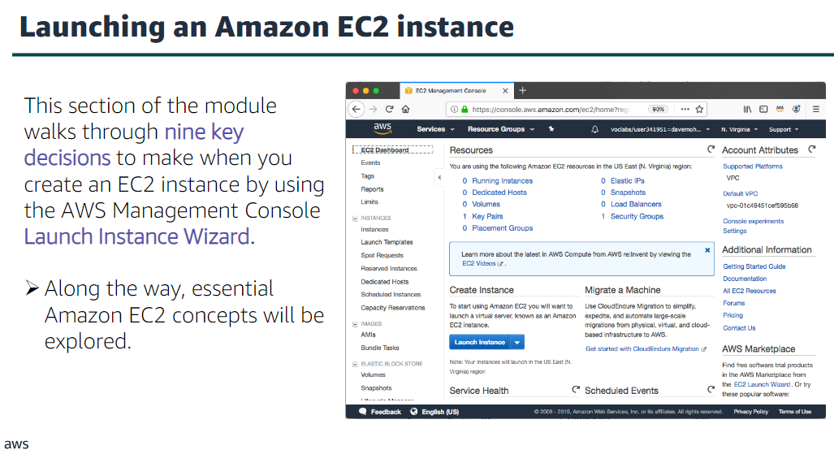

Slide 6
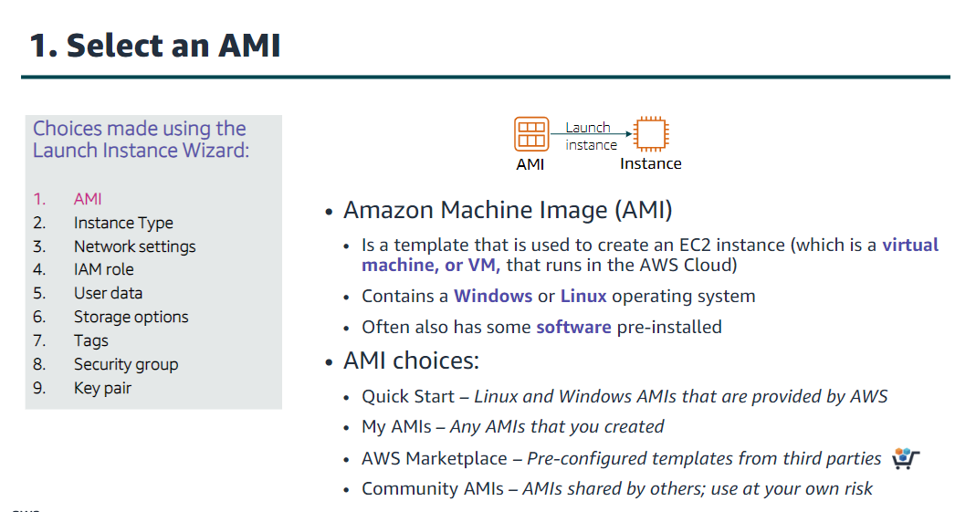

Slide 7
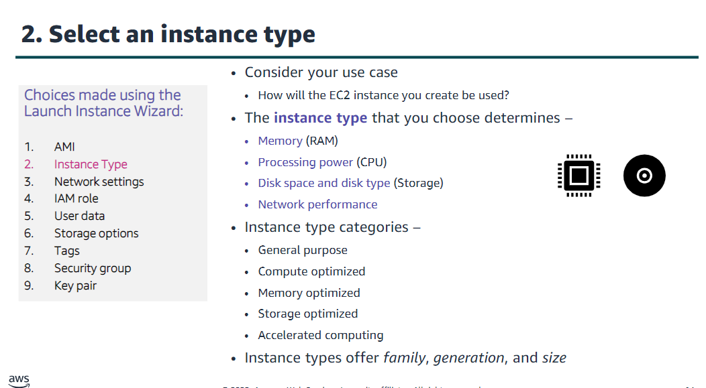

Slide 8
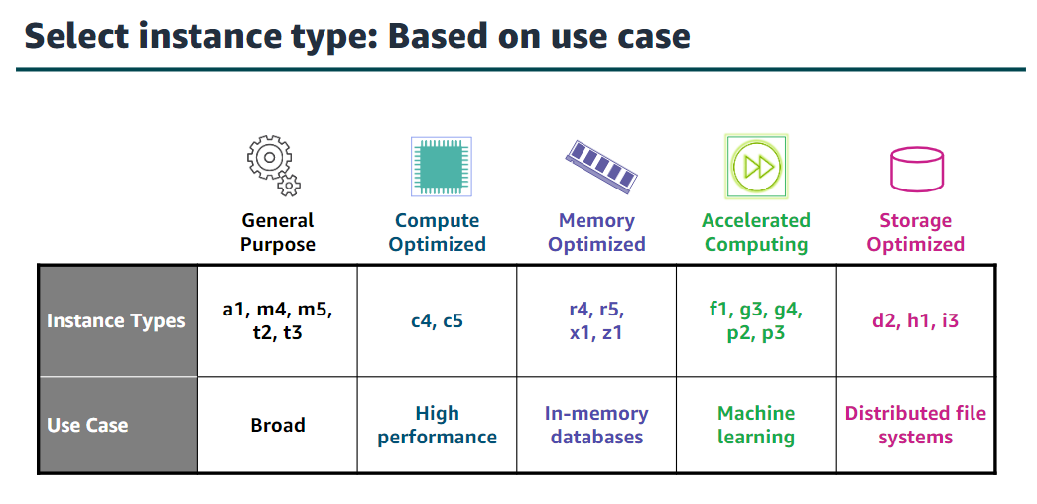

Slide 9
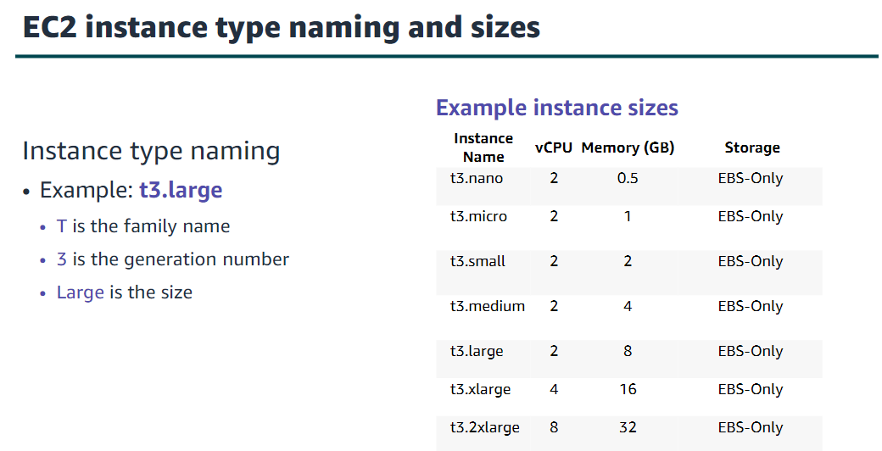

Slide 10
AWS EC2 Instance Types
1. General Purpose Instances
It provides the balanced resources for a wide range of workloads.
It is suitable for web servers, development environments, and small databases.
Examples: T3, M5 instances.
2. Compute Optimized Instances
It provides high-performance processors for compute-intensive applications.
It will be Ideal for high-performance web servers, scientific modeling, and batch processing.
Examples: C5, C6g instances.

Slide 11
AWS EC2 Instance Types
3. Memory-Optimized Instances
High memory-to-CPU ratios for large data sets.
Perfect for in-memory databases, real-time big data analytics, and high-performance computing (HPC).
Examples: R5, X1e instances.
4. Storage Optimized Instances
It provides optimized resource of instance for high, sequential read and write access to large data sets.
Best for data warehousing, Hadoop, and distributed file systems.
Examples: I3, D2 instances.

Slide 12
AWS EC2 Instance Types
5. Accelerated Computing Instances
It facilitates with providing hardware accelerators or co-processors for graphics processing and parallel computations.
It is ideal for machine learning, gaming, and 3D rendering.
Examples: P3, G4 instances.

Slide 13
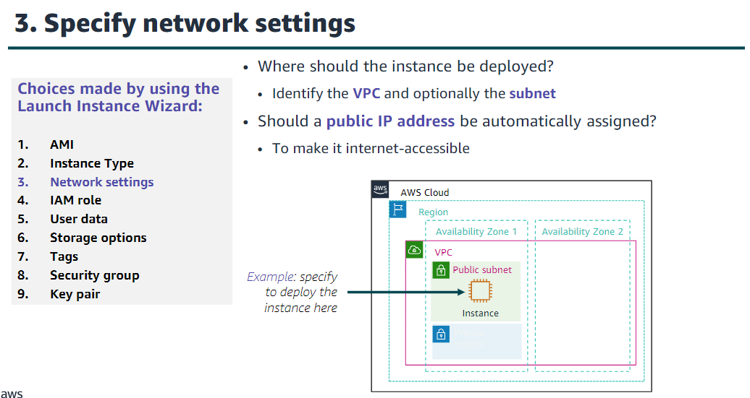

Slide 14
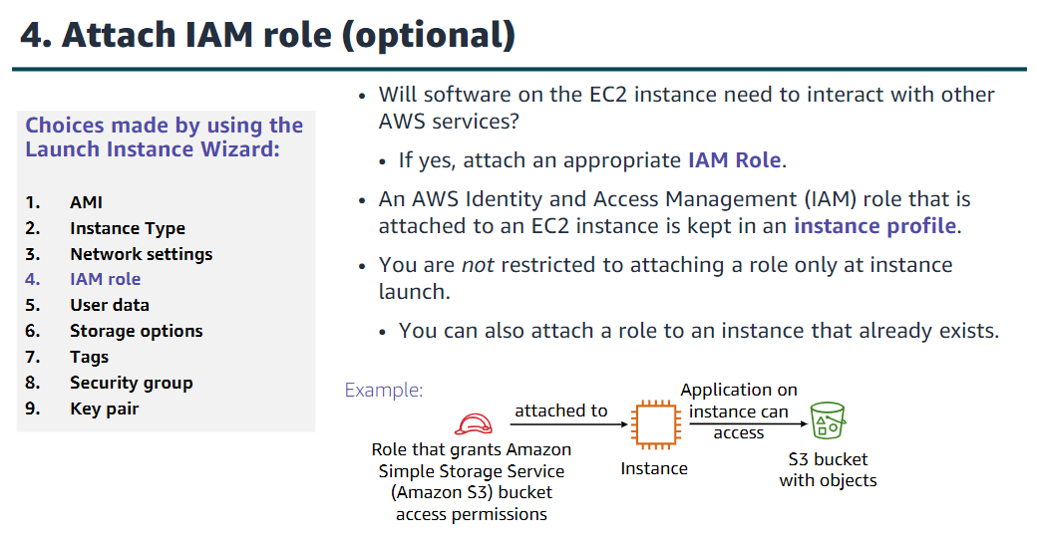

Slide 15
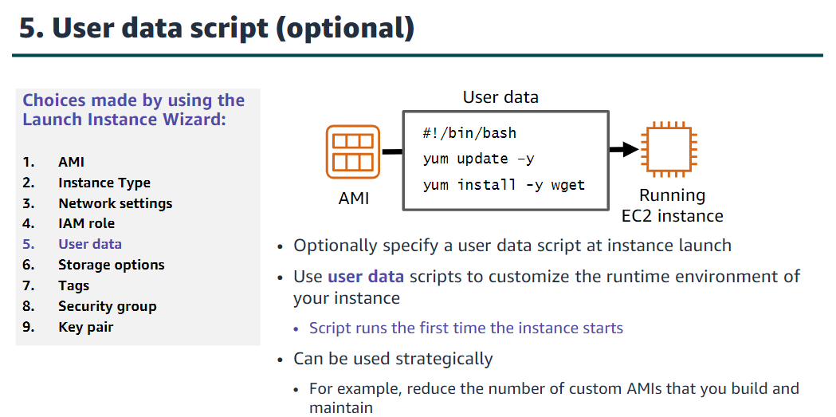

Slide 16
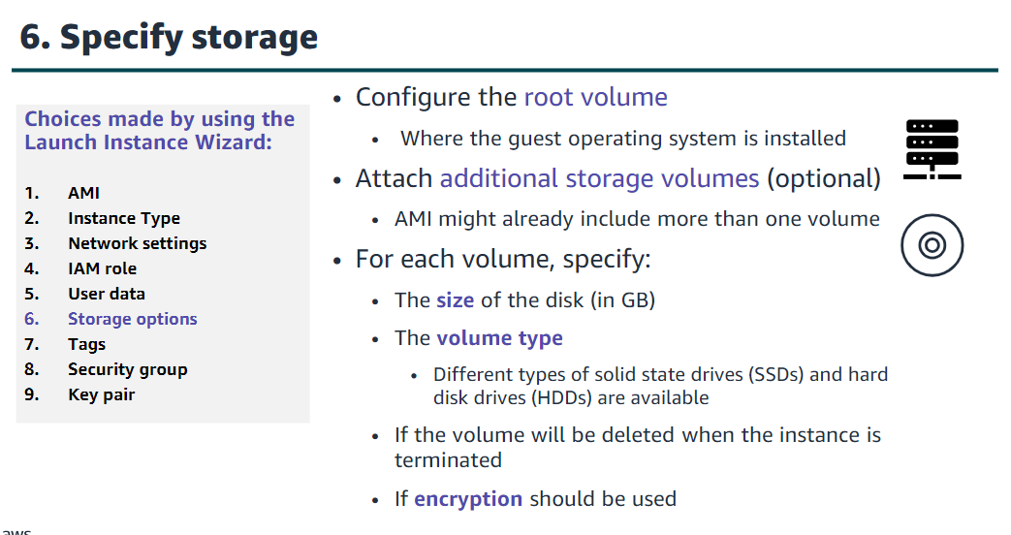

Slide 17
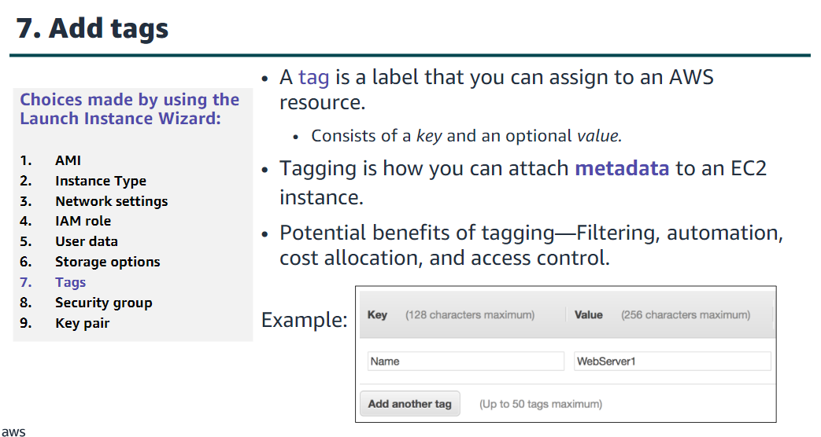

Slide 18
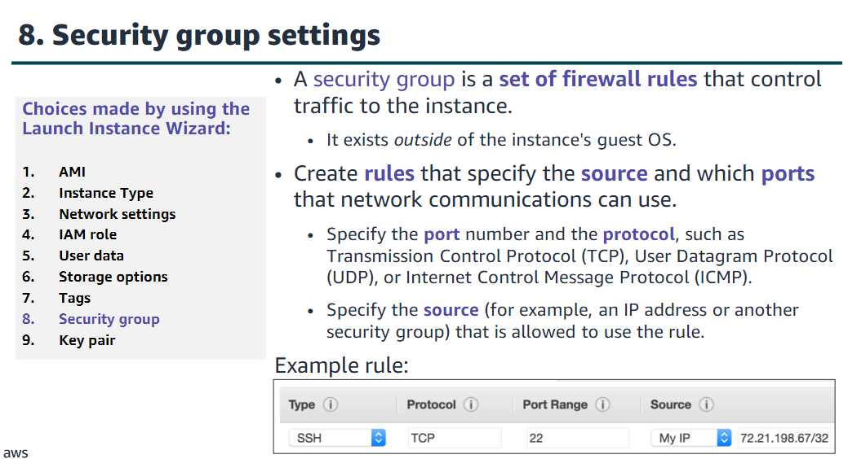

Slide 19
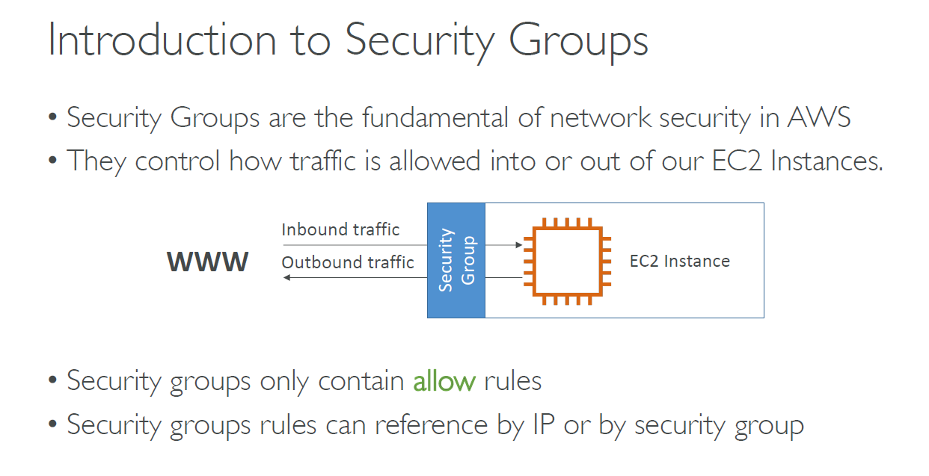

Slide 20
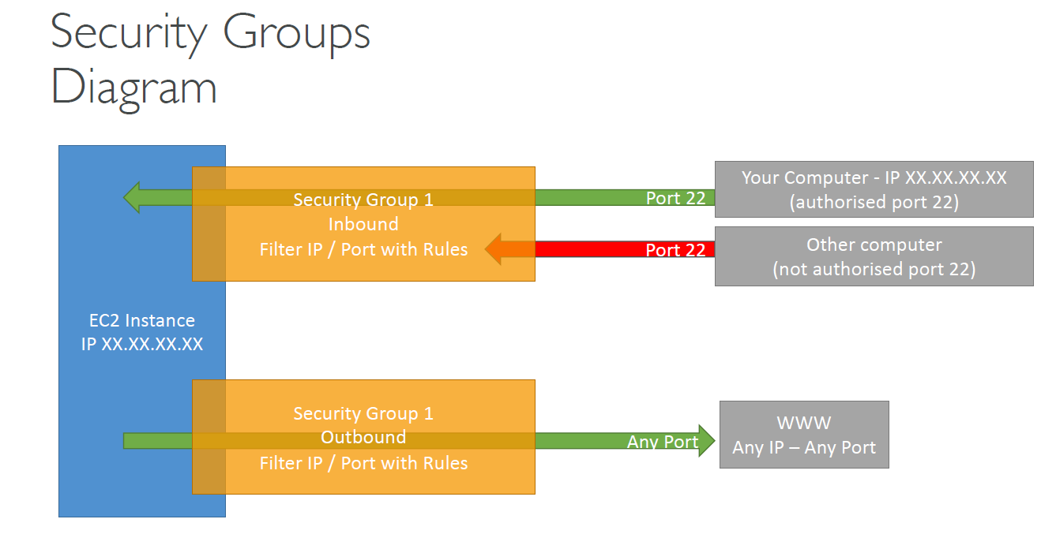

Slide 21
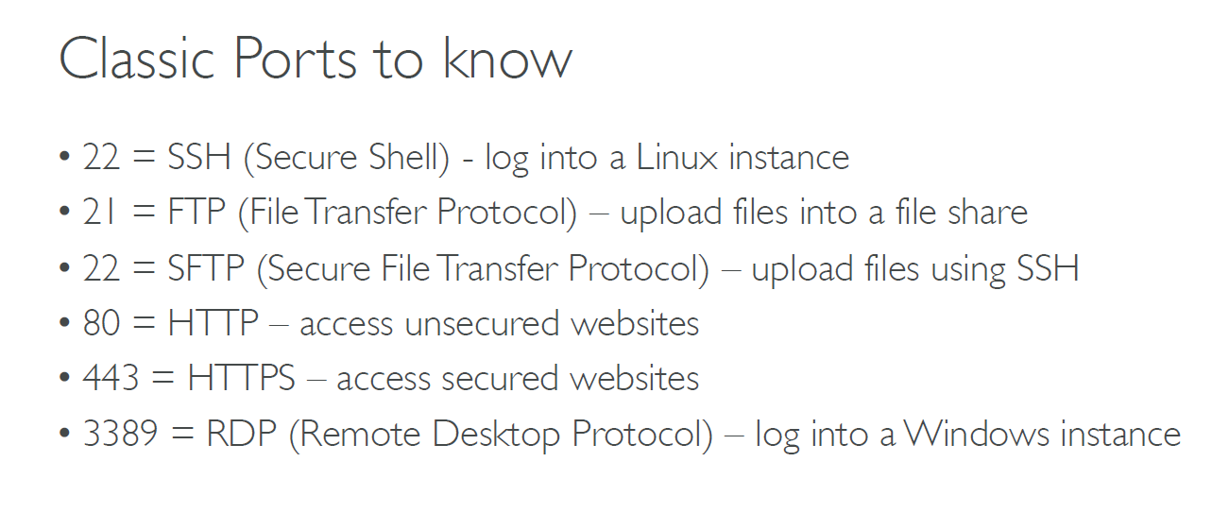

Slide 22
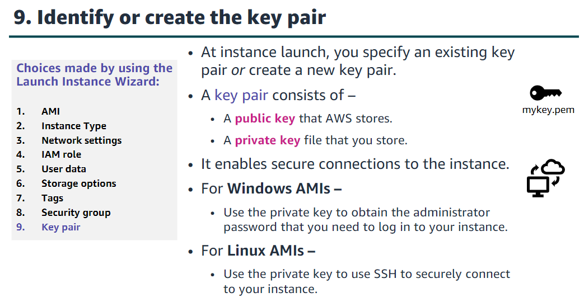

Slide 23
Features of AWS EC2 (Elastic Compute Cloud)
The following are the features of AWS EC2:
1. AWS EC2 Functionality
EC2 provides its users with a true virtual computing platform, where they can use various operations and even launch another EC2 instance from this virtually created environment. This will increase the security of the virtual devices.
Not only creating but also EC2 allows us to customize our environment as per our requirements, at any point of time during the life span of the virtual machine.
Amazon EC2 itself comes with a set of default AMI(Amazon Machine Image) options supporting various operating systems along with some pre-configured resources like RAM, ROM, storage, etc.
Besides these AMI options, we can also create an AMI curated with a combination of default and user-defined configurations. And for future purposes, we can store this user-defined AMI, so that next time, the user won’t have to re-configure a new AMI(Amazon Machine Image) from scratch. Rather than this whole process, the user can simply use the older reference while creating a new EC2 machine.

Slide 24
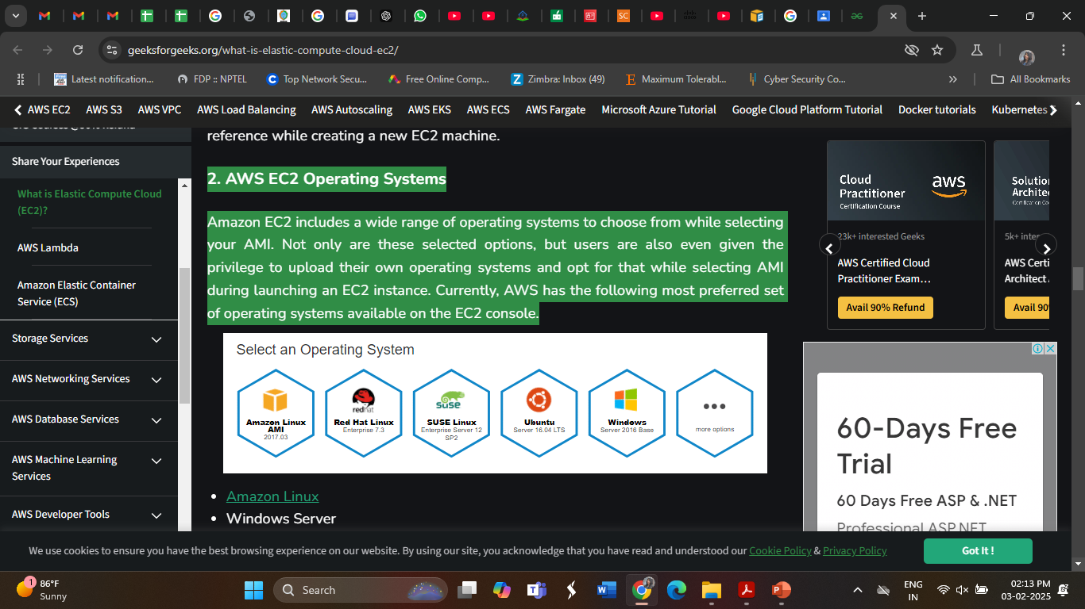
Features of AWS EC2 (Elastic Compute Cloud)
2. AWS EC2 Operating Systems
Amazon EC2 includes a wide range of operating systems to choose from while selecting your AMI.
Not only are these selected options, but users are also even given the privilege to upload their own operating systems and opt for that while selecting AMI during launching an EC2 instance.
Currently, AWS has the following most preferred set of operating systems available on the EC2 console.
Amazon Linux
Windows Server
Ubuntu Server
SUSE Linux
Red Hat Linux

Slide 25
Features of AWS EC2 (Elastic Compute Cloud)
3. AWS EC2 Software
Amazon is single-handedly ruling the cloud computing market, because of the variety of options available on EC2 for its users.
It allows its users to choose from various software present to run on their EC2 machines.
This whole service is allocated to AWS Marketplace on the AWS platform. Numerous software like SAP, LAMP, Drupal, etc are available on AWS to use.

Slide 26
Features of AWS EC2 (Elastic Compute Cloud)
4. AWS EC2 Scalability and Reliability
EC2 provides us the facility to scale up or scale down as per the needs.
All dynamic scenarios can be easily tackled by EC2 with the help of this feature. And because of the flexibility of volumes and snapshots, it is highly reliable for its users.
Due to the scalable nature of the machine, many organizations like Flipkart, and Amazon rely on these days whenever humongous traffic occurs on their portals.

Slide 27
EC2 Pricing Models
Amazon EC2 offers four pricing options for instances: On-Demand Instances, Reserved Instances, Spot Instances, and Dedicated Hosts.
On-Demand Instances: The On-Demand instance is like a pay-as-you-go model where you have to pay only for the time you are going to use if the instance is stopped then the billing for that instance will be stopped when it was in the running state then you are going to be charged. The billing will be done based on the time EC2-Instance is running.
Reserved Instances (Saving Plans): Reversed Instance is like you are going to give the commitment to the AWS by buying the instance for one year or more than one year by the requirement to your organization. Because you are giving one year of Commitment to the AWS they will discount the price on that instance.
Spot Instances: You have to bid the instances and who will win the bid they are going to get the instance for use but you can’t save the data which is used in this type of instance. Here you can get upto 90% of discount compared to On-Demand instances
Dedicated Host Reservation: It provides you with a discount of up to 70% compared to On-Demand pricing. Here, you pay for each active dedicated host you use, regardless of the number or size of instances running on that host,

Slide 28
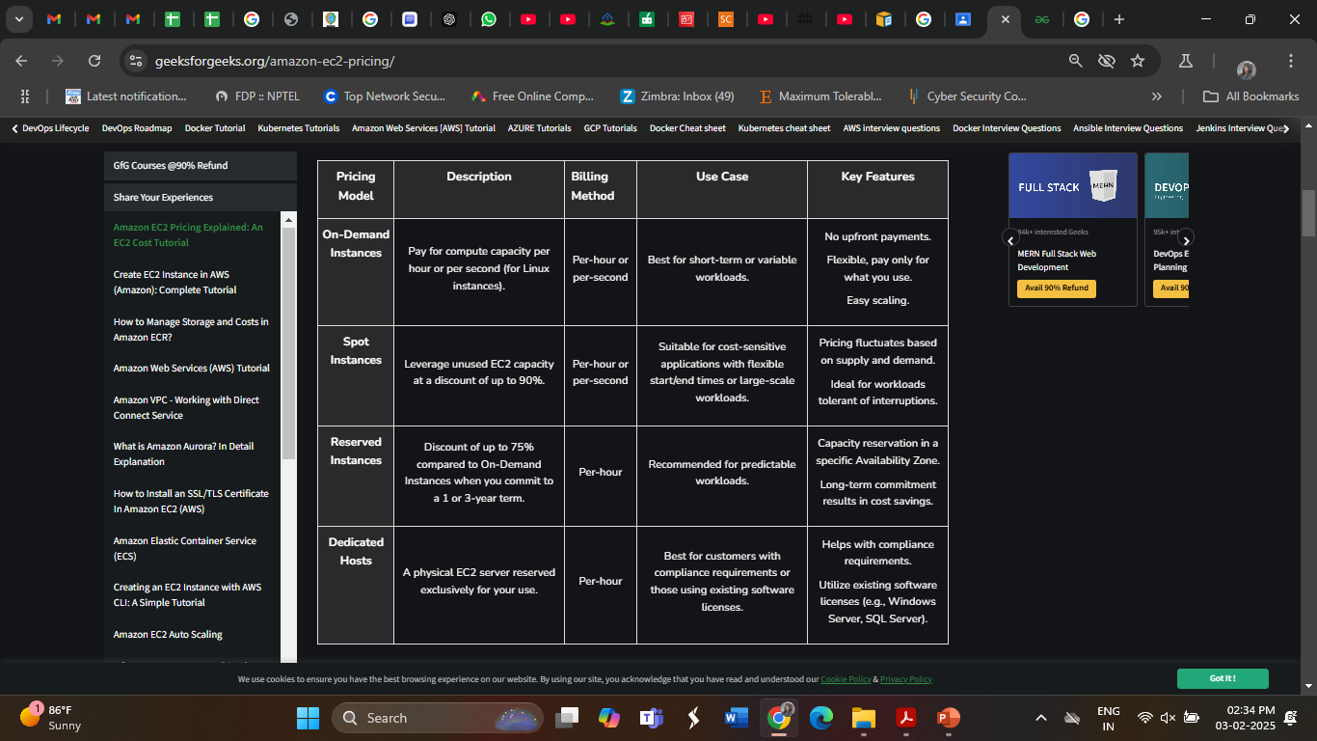
EC2 Pricing Models

Slide 29
EC2 Pricing Models
Per-Second Billing Scheme For Amazon EC2
Many customers utilize Amazon EC2 to accomplish significant tasks in a very short time, sometimes just minutes or even seconds. In 2017, AWS introduced per-second billing for Linux instance usage across On-Demand, Reserved, and Spot Instances. The minimum billing duration is one minute (60 seconds), but after that initial minute, charges are applied on a per-second basis. However, if you start and then stop an instance within 30 seconds, you will still be billed for the full 60 seconds.
This per-second billing option is available for all instances launched in:
On-Demand Instances
Reserved Instances
Spot instances
All regions
All Availability Zones
Amazon Linux
Windows
Ubuntu

Slide 30
Key Components Of Amazon EC2 Costs
When estimating the costs associated with Amazon EC2, it’s essential to consider several key components:
Server Time Charges: Billing for EC2 resources begins the moment your instances are launched and continues until they are terminated. Additionally, charges apply from the time an Elastic IP address is allocated until it is released.
Instance Type Selection:EC2 instance types consist of various combinations of resources, such as CPU, memory, networking capabilities, and storage options. You can scale instance sizes according to the specific needs of your workload, allowing for customization and optimization.
Number of Instances: The pricing model for AWS EC2 is influenced by the number of instances you are running simultaneously. Provisioning multiple instances can impact overall costs.
Elastic Load Balancing: To manage traffic effectively, AWS provides Elastic Load Balancing, which distributes incoming traffic across your EC2 instances. The total hours that Elastic Load Balancing is active will contribute to your monthly expenses.

Slide 31
Key Components Of Amazon EC2 Costs
Monitoring Features: Amazon EC2 integrates with Amazon CloudWatch for monitoring capabilities. While basic monitoring is included by default, opting for detailed monitoring incurs a fixed monthly fee.
Elastic IP Addresses: AWS offers one Elastic IP address per running instance at no additional cost. However, any additional Elastic IPs may lead to extra charges.
Software Licensing: AWS provides flexibility in software licensing, allowing you to either obtain licenses through AWS or bring your own. AWS licenses operate on a “pay-as-you-go” basis, while using your own licenses can lower total cost of ownership (TCO), provided the agreements align with cloud use. AWS License Manager can assist in managing your software licenses effectively.

Slide 32
AWS Elastic IP Addresses
A Static IPv4 address more suited for dynamic cloud computing is called an Elastic IP (EIP) address. These IPs are mostly used to hide instances or software from your AWS account that fail.
The address is mapped to another instance that is as soon as feasible made available in your account in order to accomplish this. Your AWS account receives an IP address automatically, and until you choose to surrender it, it is yours. As an alternative, you can add the IP to a DNS record for your domain. Making sure the supplied domain points to your instance using this will do that.
The internet can be used to access this address just like any other public IPv4 address. If your instance lacks a public IPv4 address that allows communication from the internet to the instance, you can associate this IP address with it.
The AWS EIP does not currently support IPv6 addresses.

Slide 33
Working of AWS Elastic IP
The working of AWS Elastic IP can be explained in the following manner:
1. Allocate an Elastic IP Address: It is easy to assign an IP address to your account. Your IP address may be assigned using either the pool of IP addresses offered by Amazon or the private IP address pool you have added to your account.
There are the following options for the Public IPv4 address pool:
IPv4 Addresses are available on Amazon: If you want an IPv4 address assigned from the pool of IPv4 numbers maintained by Amazon.
My Collection of Open IPv4 Addresses: If you wish to assign an IPv4 address from a pool of IP addresses you’ve added to your AWS account. If your network does not contain any IP address pools, this option is disabled.
The IPv4 Address Pool that belongs to the Customer: If you need to distribute an IPv4 address for use with AWS Outposts from a pool made using your on-premises network. If you don’t have AWS Outposts, this option isn’t available to you.

Slide 34
Working of AWS Elastic IP
2. Describe your Elastic IP Address: In this step, one can view all the metadata of the Elastic IP Address by visiting the View Information Portal. Here the metadata includes the name, descriptions, port numbers assigned, and other necessary details.
3. Tag an Elastic IP Address: You can use tags to distinguish between your IP addresses in case you have created multiple IP addresses.
4. Connect or Disconnect an Elastic IP address from a Network Interface or Instance
5. Release an Elastic IP Address: We advise releasing an Elastic IP address if you no longer require it. The IP that needs to be released cannot currently be connected to any EC2 instance, NAT gateway, or Network Load Balancer on AWS.

Slide 35
Features of AWS Elastic IP
1. Static Public IPv4 Address
An Elastic IP is a permanent public IP address that remains constant until you manually release it.
Unlike dynamically assigned public IPs, an Elastic IP does not change on instance stop/start.
2. Failover & High Availability
You can remap an Elastic IP to another EC2 instance in case of failure.
This helps ensure business continuity by quickly switching traffic to a backup instance.
3. Dynamic Reassignment
You can detach and reassign an Elastic IP from one instance to another instantly.
This allows for load balancing and failover solutions without changing DNS settings

Slide 36
Features of AWS Elastic IP
4. One Free Elastic IP Per Running Instance
AWS provides one free Elastic IP per running EC2 instance.
However, if the Elastic IP is not associated with an instance, AWS charges you for it.
5. Elastic IP Pooling
You can allocate multiple Elastic IPs and manage them in a pool.
Useful for large-scale architectures needing multiple static public Ips.
6. IPv4-Only
Elastic IPs are available only for IPv4 addresses, as AWS does not provide Elastic IPv6.
AWS provides IPv6 addresses differently (e.g., Egress-Only Internet Gateway for IPv6)

Slide 37
AWS Elastic Beanstalk
AWS Elastic Beanstalk is an AWS-managed service for web applications.
Elastic Beanstalk is a pre-configured EC2 server that can directly take up your application code and environment configurations and use it to automatically provision and deploy the required resources within AWS to run the web application.
Unlike EC2 which is Infrastructure as a service, Elastic Beanstalk is a Platform As A Service (PAAS) as it allows users to directly use a pre-configured server for their application.
Of course, you can deploy applications without ever having to use elastic beanstalk but that would mean having to choose the appropriate service from the vast array of services offered by AWS, manually provisioning these AWS resources, and stitching them up together to form a complete web application.
Elastic Beanstalk abstracts the underlying configuration work and allows you as a user to focus on more pressing matters.

Slide 38
How Elastic Beanstalk Works ?
To use Elastic Beanstalk, you create an application, upload an application version in the form of an application source bundle (for example, a Java .war file) to Elastic Beanstalk, and then provide some information about the application.
Elastic Beanstalk automatically launches an environment and creates and configures the AWS resources needed to run your code. After your environment is launched, you can then manage your environment and deploy new application versions.
After you create and deploy your application, information about the application—including metrics, events, and environment status—is available through the Elastic Beanstalk console, APIs, or Command Line Interfaces, including the unified AWS CLI.

Slide 39
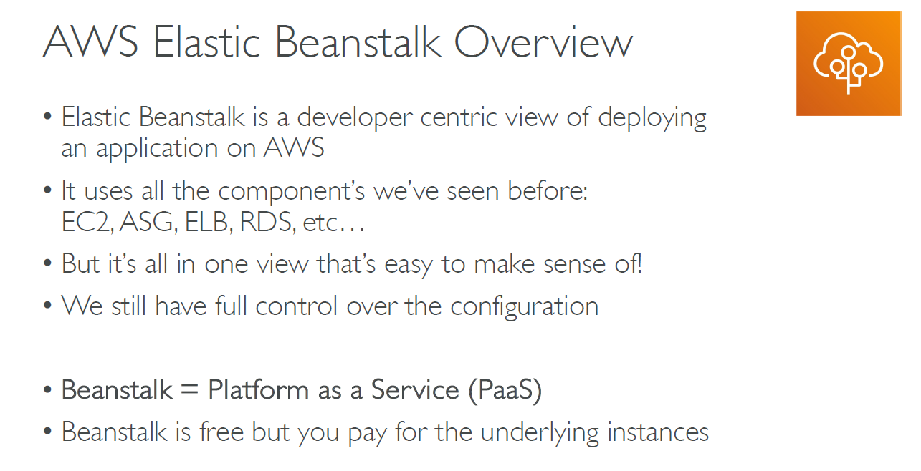
.

Slide 40
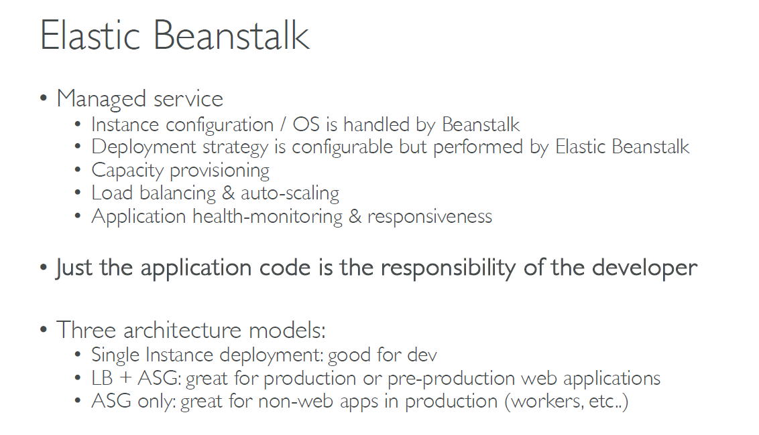
.

Slide 41
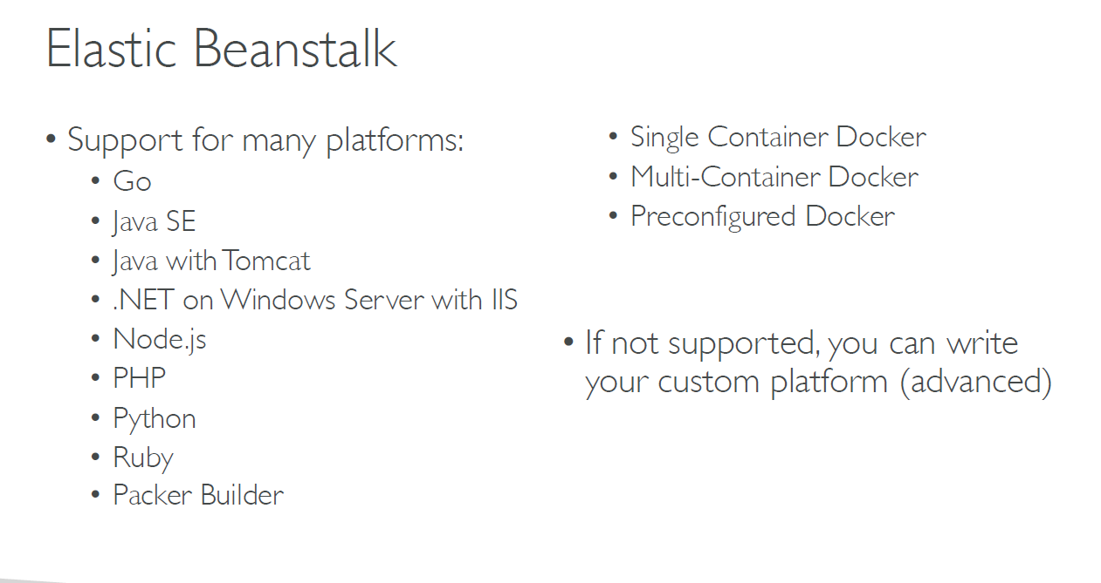
.

Slide 42
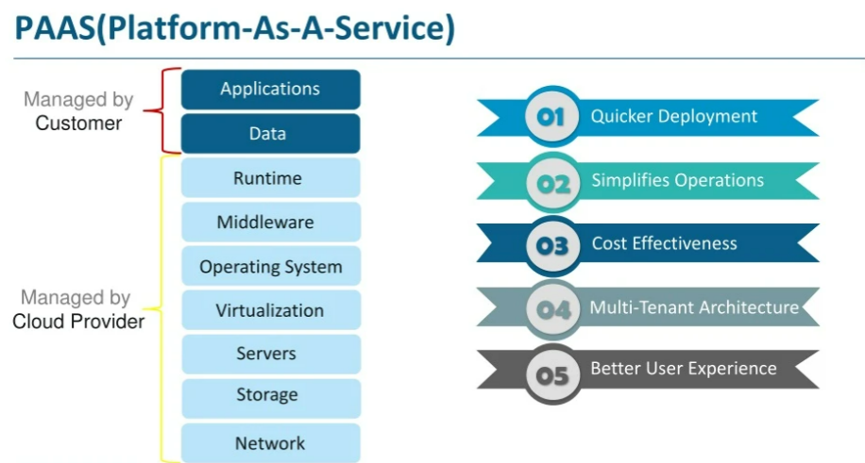
.

Slide 43
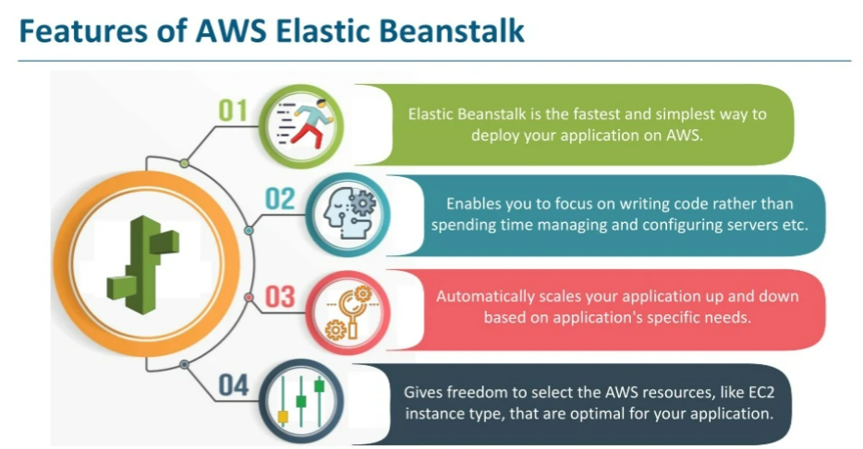
.

Slide 44
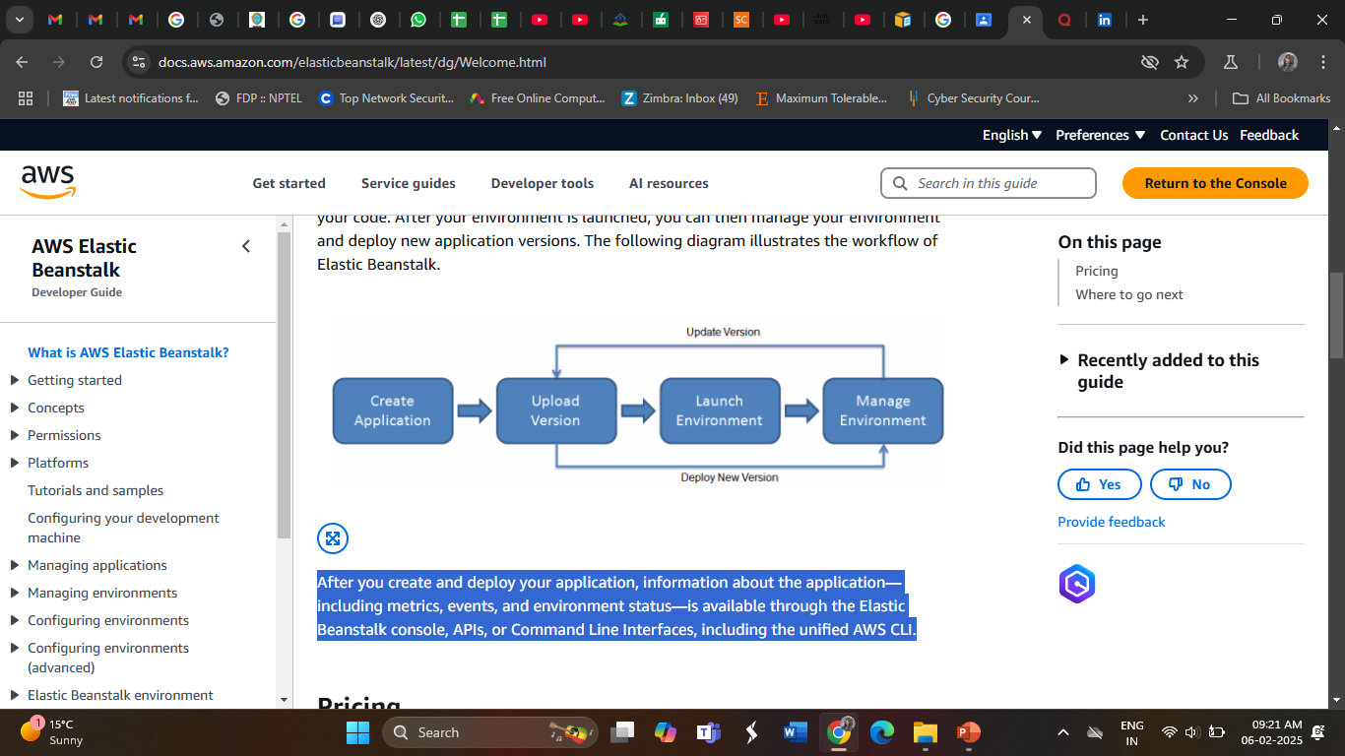
How Elastic Beanstalk Works ?

Slide 45
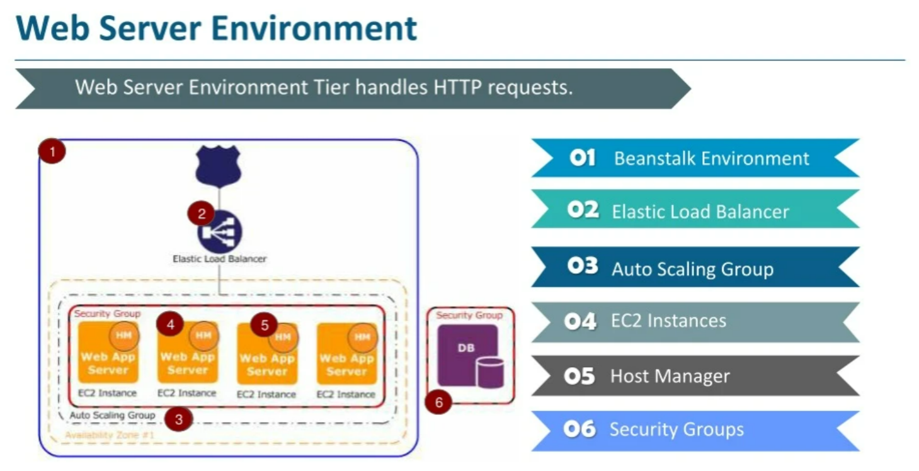
How Elastic Beanstalk Works ?

Slide 46
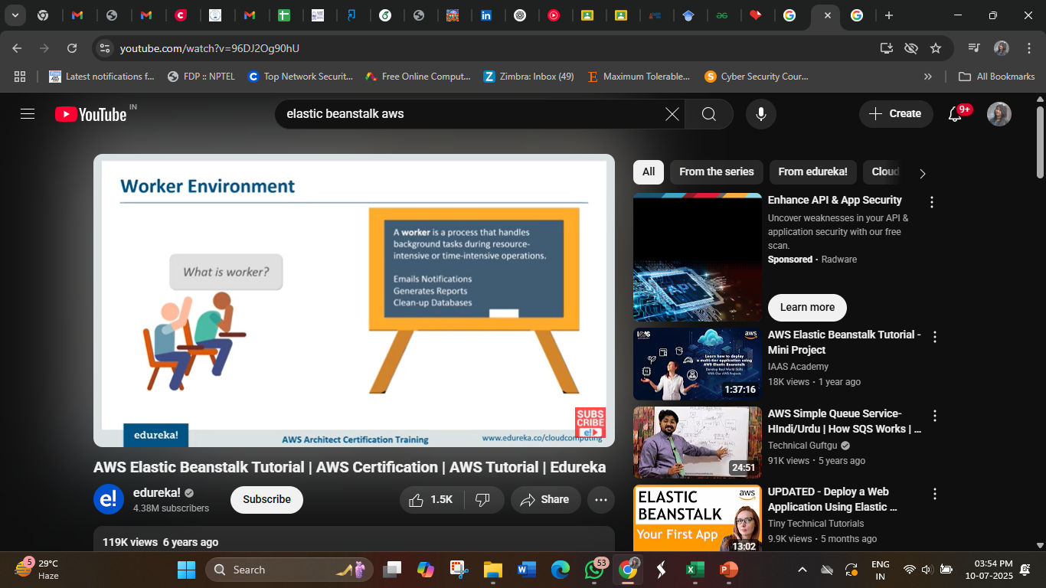

Slide 47
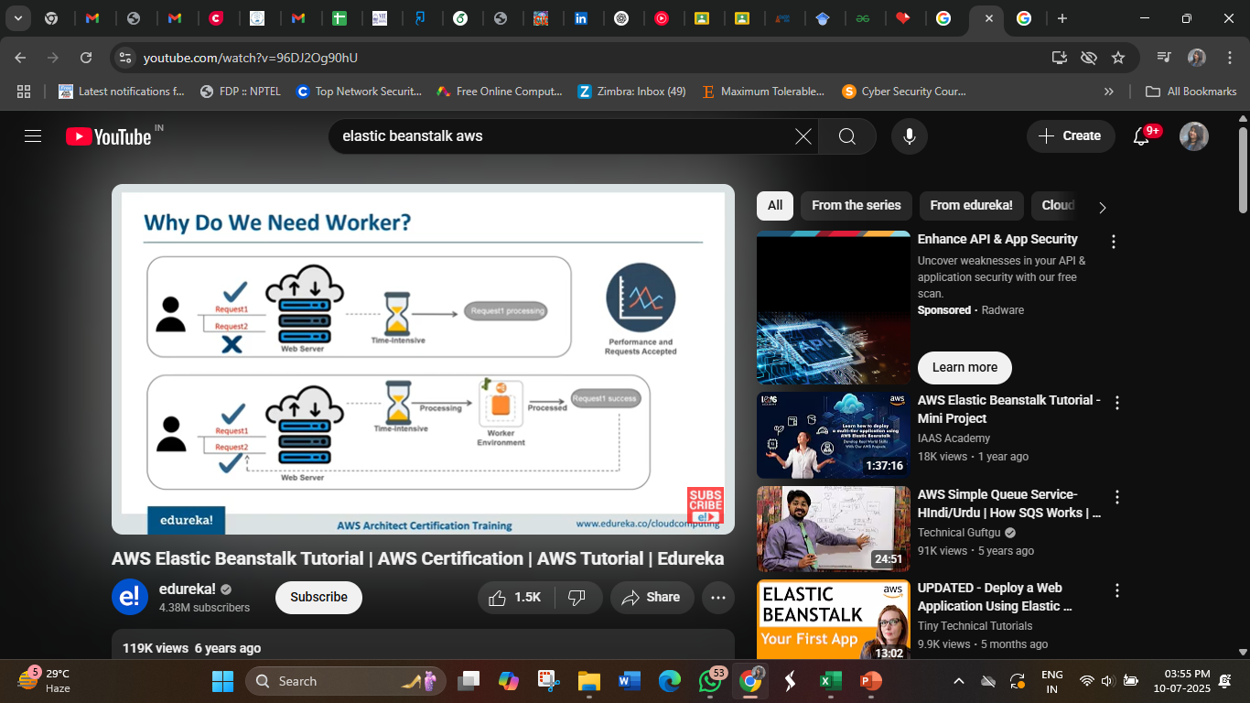

Slide 48
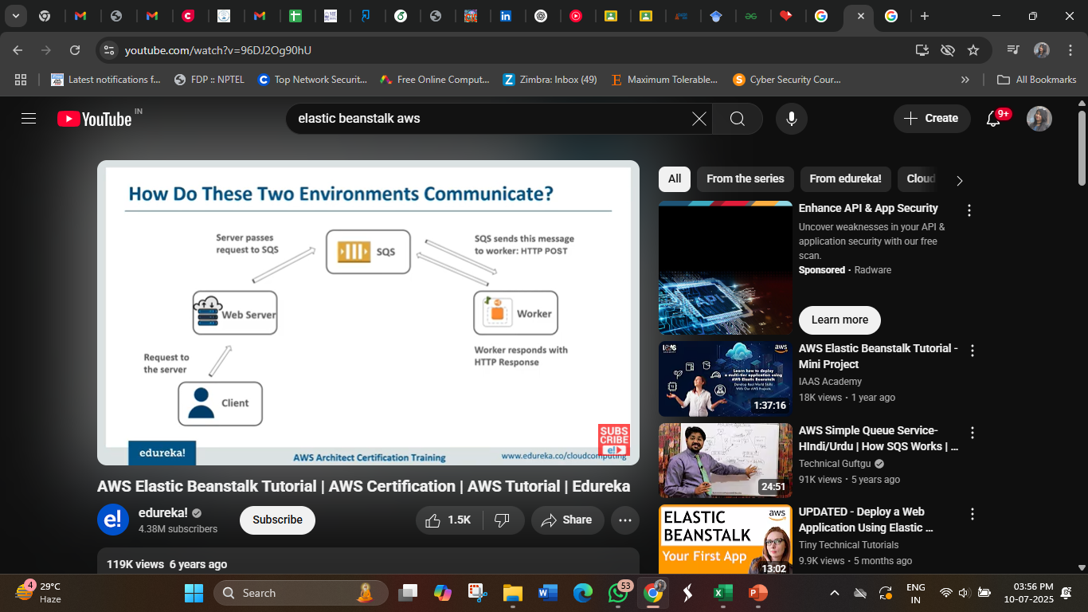

Slide 49
Elastic Beanstalk Features
Elastic Beanstalk offers preconfigured runtime-like environments and deployment tools which makes it easy to deploy our application
It supports numerous platforms and programming languages like GO, Python java, etc.
Elastic Beanstalk scales your application automatically when the demand increases with the help of auto-scaling rules.
Elastic Beanstalk can integrate with databases such as Mysql, Oracle, and Microsoft SQL Server.
Access control via AWS Identity and Access Management and built-in security features like SSL/TLS encryption are provided by Elastic Beanstalk (IAM).

Slide 50
AWS Fargate
AWS Fargate is a feature in container services in Amazon Web Services that can be used to run your containers without having to manage the server or the underlying architecture.
It is a serverless computing engine for containers. It is a pay-as-you-go model, i.e. pay for the resources you are using.
It is one of the most important features of serverless computing in AWS. Whenever you opt for Fargate, the infrastructure will be owned and managed by AWS(Amazon Web Services).
It saves you time by automating features like patching, updating, and dealing with resources.
By running the application in the form of containers by using AWS ECS integrating with the ECS service AWS Fargate will take care of everything like server types, decide when to scale your clusters, or optimize cluster packing.

Slide 51
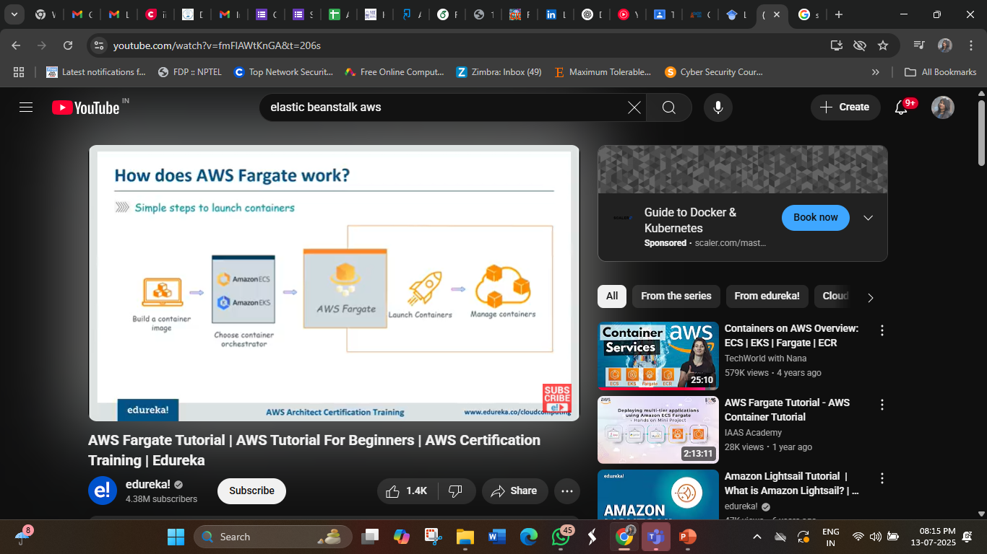
AWS Fargate

Slide 52
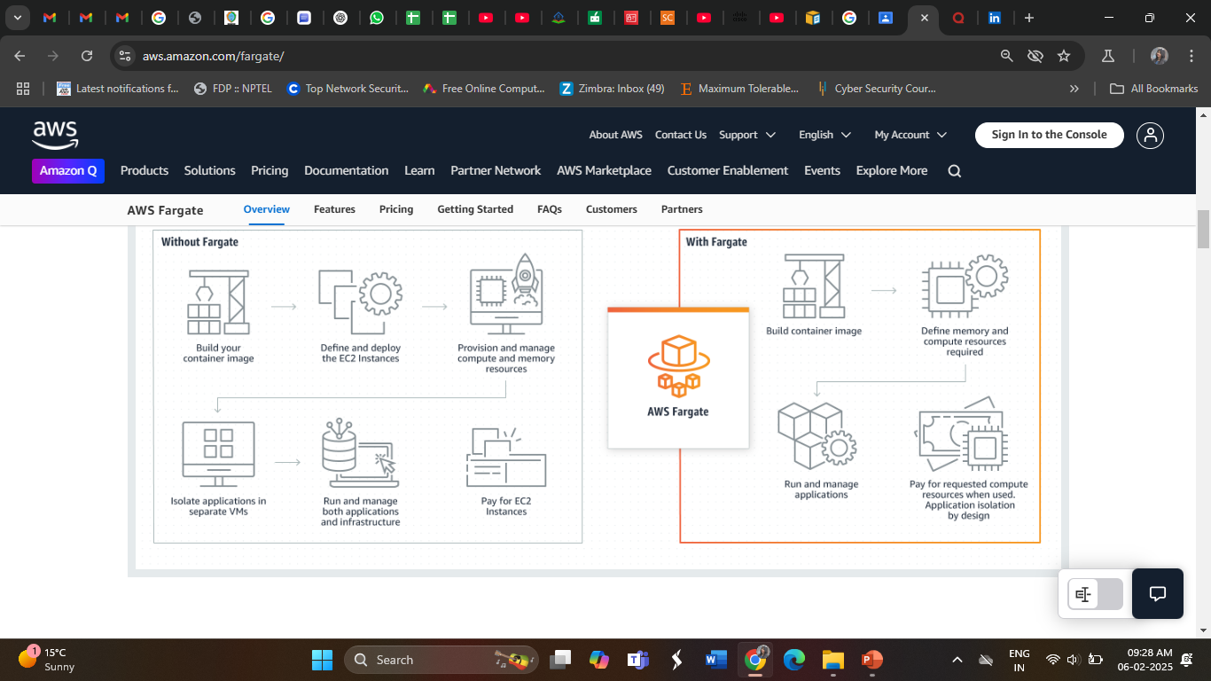
AWS Fargate

Slide 53
AWS Fargate
AWS(Amazon Web Services) offers Fargate as a service which is used to run the deploy or run the application in the form of containers of serverless compute engine. Here you do not need to worry about how to manage the servers it all will be taken care by the AWS it’s self.
You can integrate the AWS Fargate with both Elastic Kubernetes services and Elastic container service.
To use AWS Fargate, package your application into a Docker image, configure the necessary settings like CPU, memory, and networking, and let Fargate handle the rest.
Fargate runs containers in isolation within virtual machines (VMs) and charges you only for the resources consumed by your containers.

Slide 54
How AWS Fargate Works?
1. Define Your Container
Use Docker to package your application into a container.
2. Choose Elastic container service(ECS)or Elastic Kubernetes services (EKS)
Deploy on Amazon ECS (simpler) or Amazon EKS (for Kubernetes workloads).
3. Fargate Launch Type
Select Fargate instead of EC2 for running containers.
4. AWS Manages Infrastructure
AWS allocates the right CPU, memory, and networking automatically.
5. Scale Automatically
Containers scale up/down based on demand.

Slide 55
Components Of AWS Fargate
Clusters: A cluster is a logical group of resources (containers) where your applications run. It can contain multiple services and tasks running simultaneously.
Task Definitions: These are text files where the user can describe one or more containers that form the applications. They are used to define various specifications or parameters to be used in Fargate containers. They can be called the blueprint of your Fargate application.
Tasks: A task is the initialization or instantiation of the task definition. It is a running instance of a containerized application. Users can create multiple tasks from the same task definition in a cluster. Users can run a single task or multiple tasks at a time.
Services: Services is a tool in Fargate to run the tasks that have been created. A service ensures that a specified number of tasks are always running. This can be used to run multiple tasks at a time in a cluster. They also replace the tasks with new tasks based on task definition if the existing task fails or stops.

Slide 56
Amazon Elastic Container Service (ECS)
Amazon Elastic Container Service (ECS) is a fully managed container orchestration service that enables users to run Docker-based applications in containers across a cluster of EC2 instances.
ECS simplifies automated management of containerized applications at scale, allowing you to deploy, manage, and scale containerized applications efficiently.
The service supports multiple launch types, including the AWS Fargate launch type, which abstracts the underlying EC2 infrastructure, enabling you to run containers without needing to manage or provision the EC2 instances. This allows developers to focus on building and deploying applications while AWS handles the cluster management and resource provisioning. It is best for auto-scaling & simplified deployments.
ECS can also be deployed with EC2 where it runs containers on self-managed EC2 instances. It has more control over resources. It is best for fine-tuned performance & cost control.

Slide 57
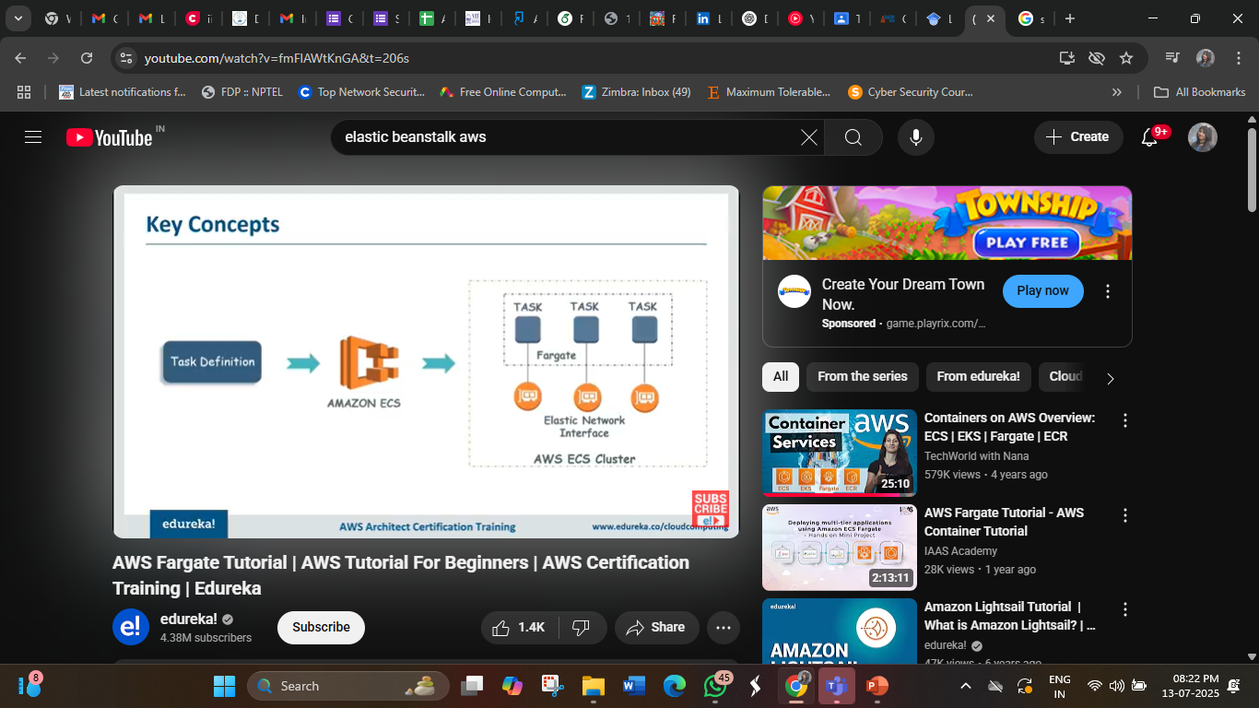
Amazon Elastic Container Service (ECS)

Slide 58
Amazon Elastic Container Service (ECS)
There are three layers in Amazon ECS:
Capacity - The infrastructure where your containers run
Controller - Deploy and manage your applications that run on the containers
Provisioning - The tools that you can use to interface with the scheduler to deploy and manage your applications and containers.
Amazon ECS capacity
Amazon ECS capacity is the infrastructure where your containers run. The following is an overview of the capacity options:
Amazon EC2 instances in the AWS cloud
You choose the instance type, the number of instances, and manage the capacity.
Serverless (AWS Fargate) in the AWS cloud
Fargate is a serverless, pay-as-you-go compute engine. With Fargate you don't need to manage servers, handle capacity planning, or isolate container workloads for security.
On-premises virtual machines (VM) or servers
Amazon ECS Anywhere provides support for registering an external instance such as an on-premises server or virtual machine (VM), to your Amazon ECS cluster.

Slide 59
Amazon Elastic Container Service (ECS)
Amazon ECS controller
The Amazon ECS scheduler is the software that manages your applications.
Amazon ECS provisioning
There are multiple options for provisioning Amazon ECS:
AWS Management Console — Provides a web interface that you can use to access your Amazon ECS resources.
AWS Command Line Interface (AWS CLI) — Provides commands for a broad set of AWS services, including Amazon ECS. It's supported on Windows, Mac, and Linux.
AWS Software Development Kit(SDKs) — Provides language-specific APIs and takes care of many of the connection details. These include calculating signatures, handling request retries, and error handling..
Copilot — Provides an open-source tool for developers to build, release, and operate production ready containerized applications on Amazon ECS.
AWS Cloud Development Kit(CDK) — Provides an open-source software development framework that you can use to model and provision your cloud application resources using familiar programming languages. The AWS CDK provisions your resources in a safe, repeatable manner through AWS CloudFormation.

Slide 60
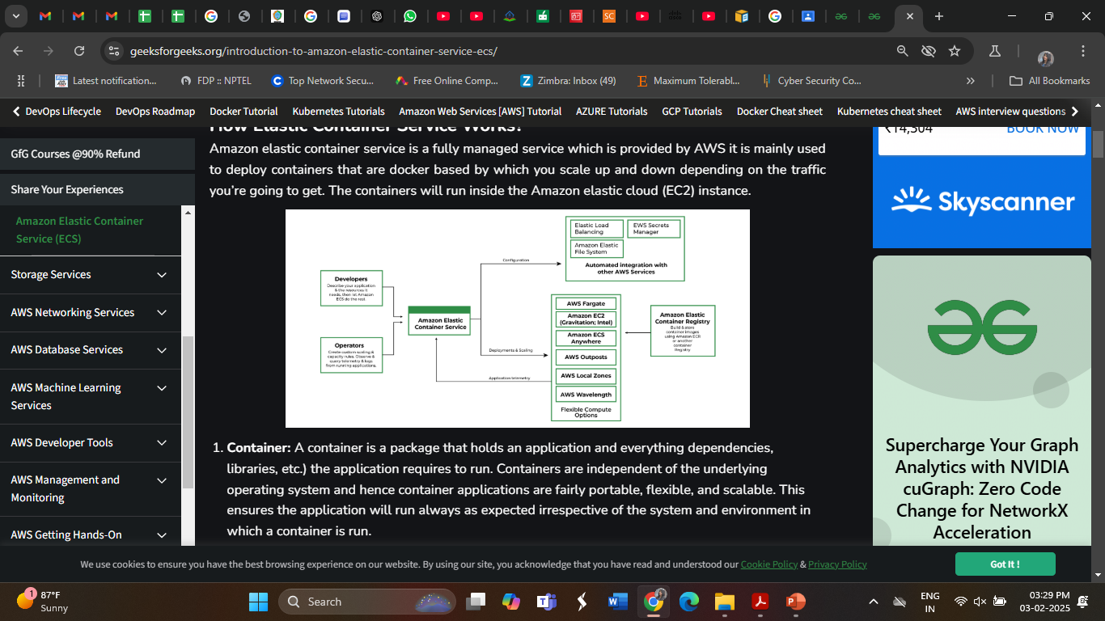
How Elastic Container Service Works?
Define a Task Definition – Specify container settings (image, CPU/memory, networking).
Create a Cluster – Group compute resources (EC2 or Fargate).
Launch a Service or Task – Deploy a containerized application.
Auto-Scale & Manage – ECS automatically scales, restarts failed tasks, and balances traffic.

Slide 61
How Elastic Container Service Works?
Container: A container is a package that holds an application and everything dependencies, libraries, etc. the application requires to run. In other words, it is a portable software package that includes everything needed to run an application (Code, Runtime, Libraries, Dependencies). Containers are independent of the underlying operating system and hence container applications are fairly portable, flexible, and scalable. This ensures the application will run always as expected irrespective of the system and environment in which a container is run.
Docker: Docker is an open-source containerization platform that allows developers to package applications with all dependencies into a single portable container. These containers can then be deployed on AWS, local servers, or any cloud platform
Cluster: A logic group of EC2 instances running as a single application.
Container Instance: Each EC2 in an ECS Cluster is called a container instance.

Slide 62
Features of ECS
Some of the features of ECS are listed below:
Removes the need for users to manage their CPU type cluster the management system by interacting with AWS Fargate.
Allows seamless deployment of container-based applications. This can be scheduled or done by simple API calls.
AWS ECS takes care of the management and monitoring of the application cluster.
Amazon ECS is region specific. This means that a cluster can only scale up/down (start-up or shut-down container instances) in a single region.
Clusters are dynamically scalable.

Slide 63
Advantages of ECS
Here are some advantages of ECS:
Scalability: ECS automatically scales your applications based on demand, allowing you to easily handle changes in traffic or workload.
High availability: ECS provides built-in availability and fault tolerance, ensuring that your applications are always up and running.
Cost-effective: ECS enables you to optimize your infrastructure costs by scaling resources based on demand and only paying for what you use.
Integration: ECS integrates with other AWS services such as Amazon ECR, AWS Fargate, Amazon CloudWatch, and AWS IAM.
Security: ECS provides a secure environment to run your applications, with features such as IAM roles for tasks, VPC isolation, and encryption at rest.

Slide 64
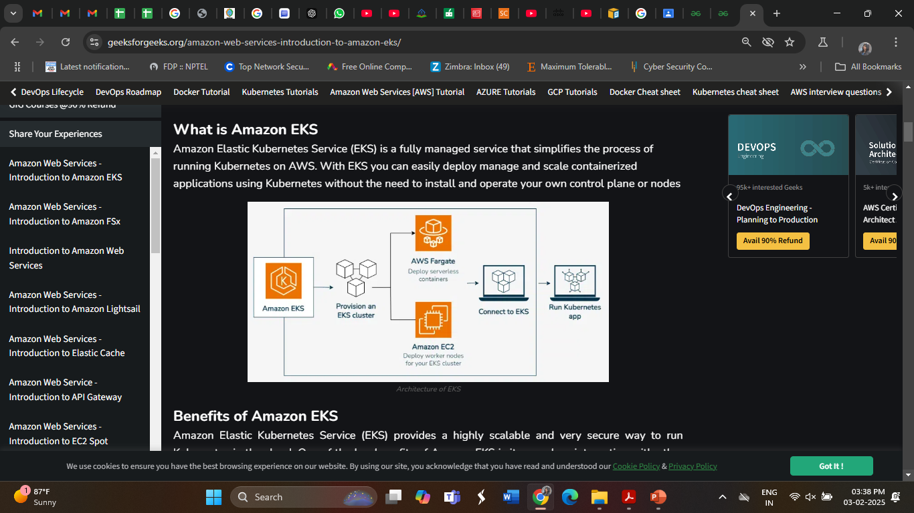
Amazon Elastic Kubernetes Service(EKS)
Amazon Elastic Kubernetes Service(EKS) is a fully managed service that you can use to run Kubernetes on Amazon Web Service.
Kubernetes is open-source software/platform that enables you to install and manage applications at a high scale. It manages large-scale deployments of containers across multiple machines. It automates the management, scaling, and deployment of containerized applications.

Slide 65
Benefits of Amazon EKS
Amazon Elastic Kubernetes Service (EKS) provides a highly scalable and very secure way to run Kubernetes in the cloud.
One of the key benefits of Amazon EKS is its seamless integration with other AWS services. This ensures that your applications can leverage the powerful ecosystem of AWS without complex configurations.
EKS also make sure of the heavy lifting in terms of managing the Kubernetes control plane which is automatically distributed across multiple availability zones. This enhances the availability and fault tolerance of your workloads.
Auto-scaling and scalability features of K8s let your cluster dynamically adjust based on the demand making it an ideal solution for applications that experience variable traffic patterns
At the End EKS provides multi-region support which Let you to deploy your Kubernetes applications across different regions for disaster recovery and high availability.
The open-source nature of Kubernetes means that Amazon EKS is compatible with existing Kubernetes tooling making it easy to migrate workloads.

Slide 66
Features of AWS EKS
Following are the Features of using Amazon EKS
Managed Kubernetes Control Plane: AWS automatically applies the latest patches and updates to the control plane keeping it secure and up to date with the latest Kubernetes versions. It make sure that control plane is distributed across multiple Availability Zones so that application should be highly available to us. AWS takes care of control plane availability, scaling, and patching EKS runs across multiple AWS Availability Zones.
Native Kubernetes Compatibility: Integrating EKS with any Kubernetes-native tools such as kubectl, Helm and more easily as EKS runs upstream Kubernetes, which means it follows the same open-source Kubernetes standards as any other Kubernetes environment. Because of this, users can seamlessly integrate and migrate workloads from other Kubernetes clusters without significant modifications.
EKS Managed Node Groups: EKS manages node updates and security patches keeping your worker nodes secure without manual intervention and can automatically scale the number of worker nodes in response to application demands, ensuring you have the right amount of compute power at all times.

Slide 67
Features of AWS EKS
Security and Compliance: IAM Roles Feature allows Kubernetes service accounts to assume specific IAM roles giving you fine-grained permissions for your Kubernetes workloads.
Hybrid and Multi-Cloud Support: EKS can be deployed across different regions and used in combination with other cloud providers for a true multi-cloud strategy and can use EKS on AWS Outposts to brings native AWS Services to your on-premise environments.

Slide 68
AWS Storage Services
1. Block Storage
Instance Store
EBS
2. Object Storage
S3
3. File Storage
EFS/FSx

Slide 69
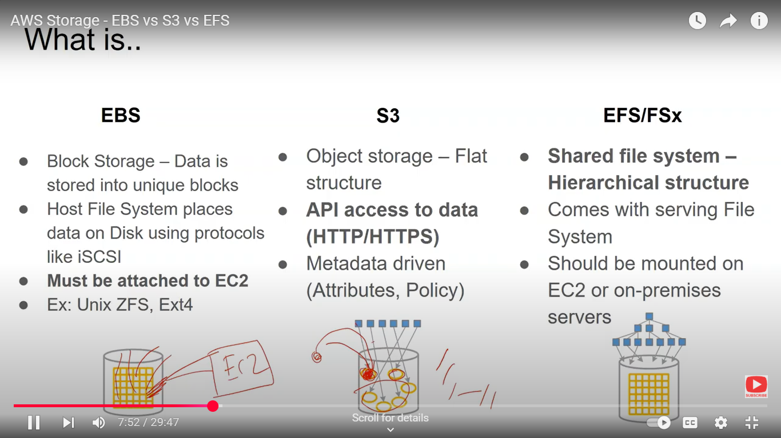
AWS Storage Services

Slide 70
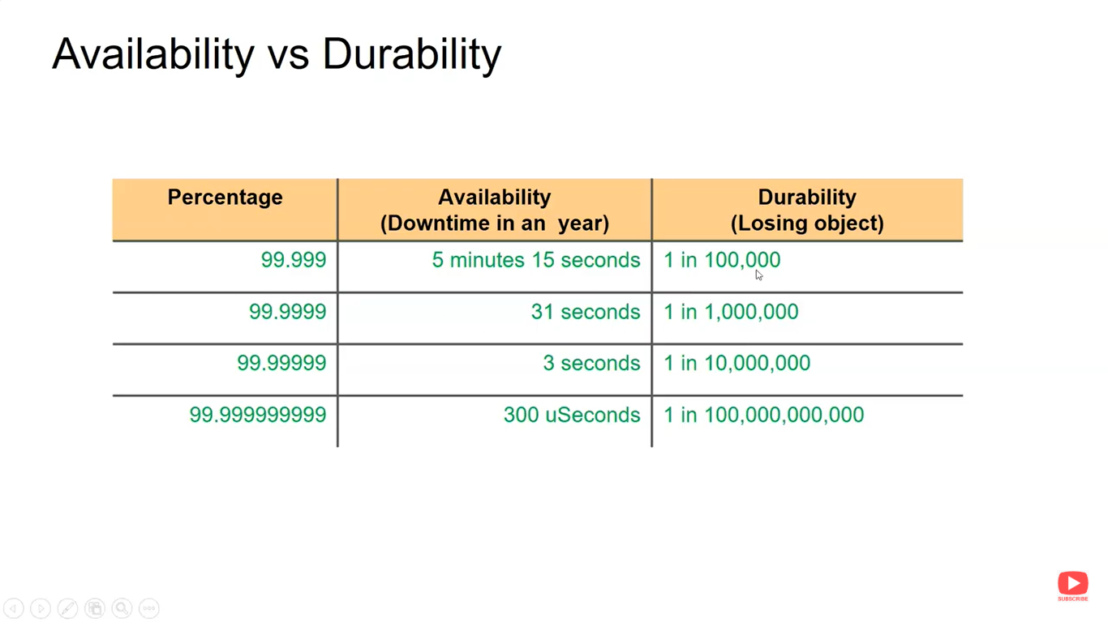
AWS Storage Services

Slide 71
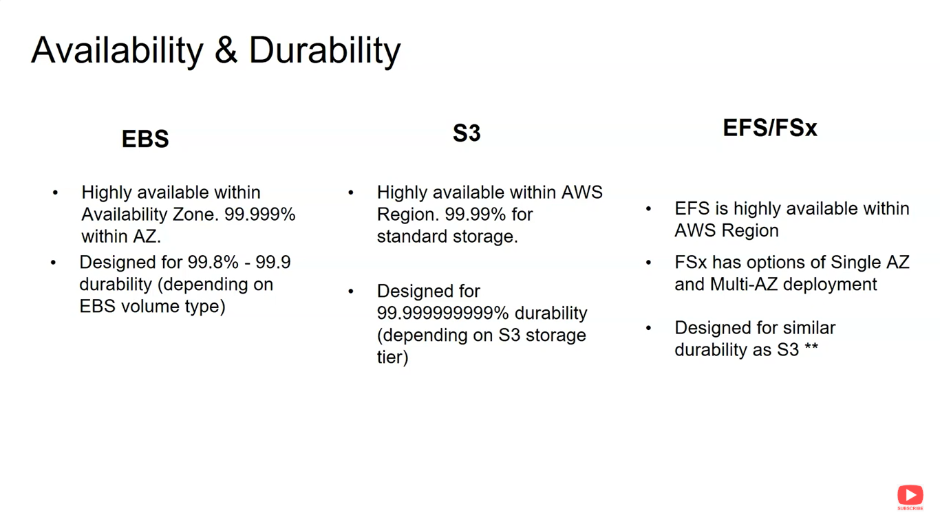
AWS Storage Services

Slide 72
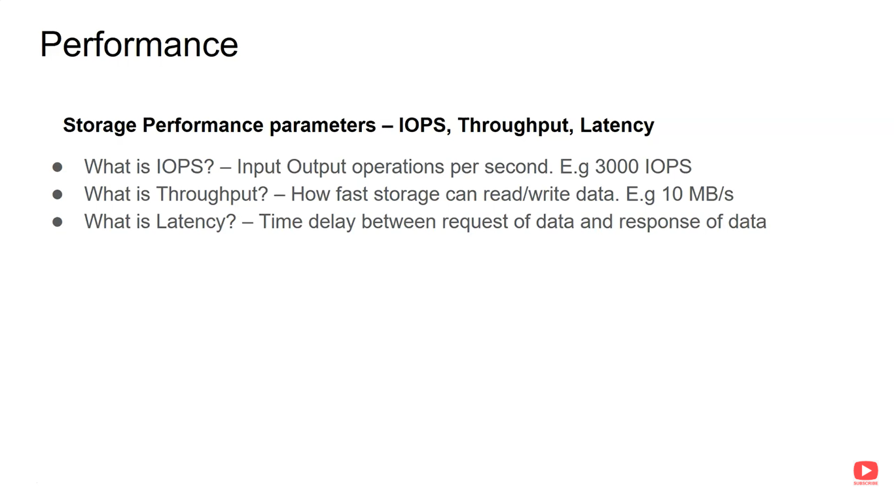
AWS Storage Services

Slide 73
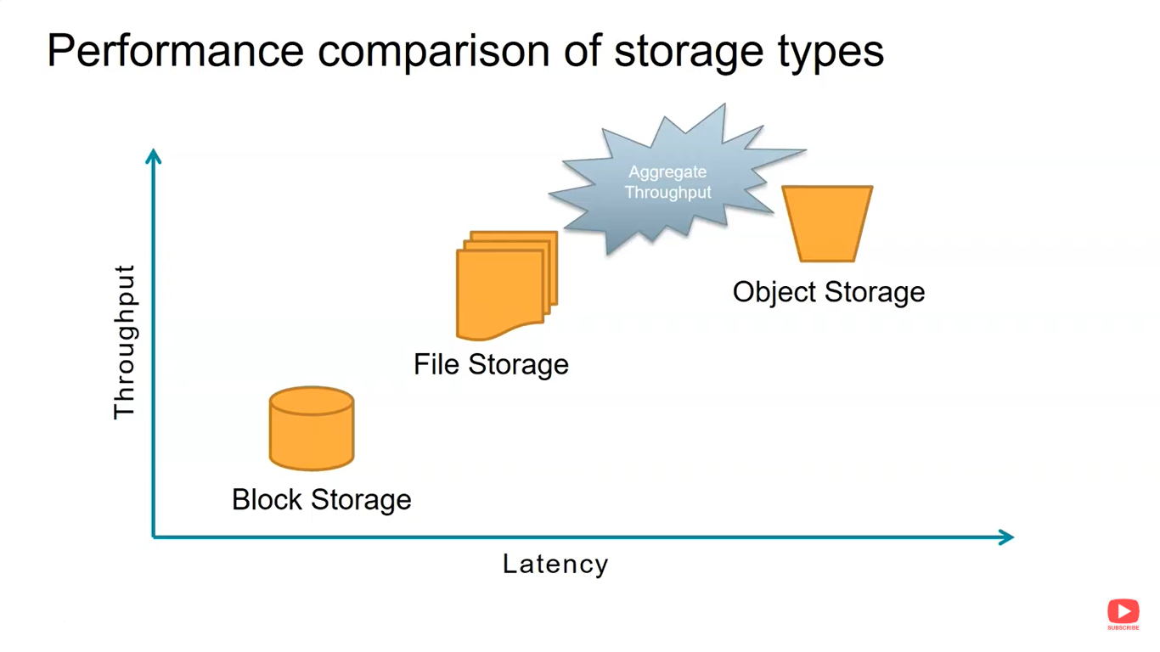
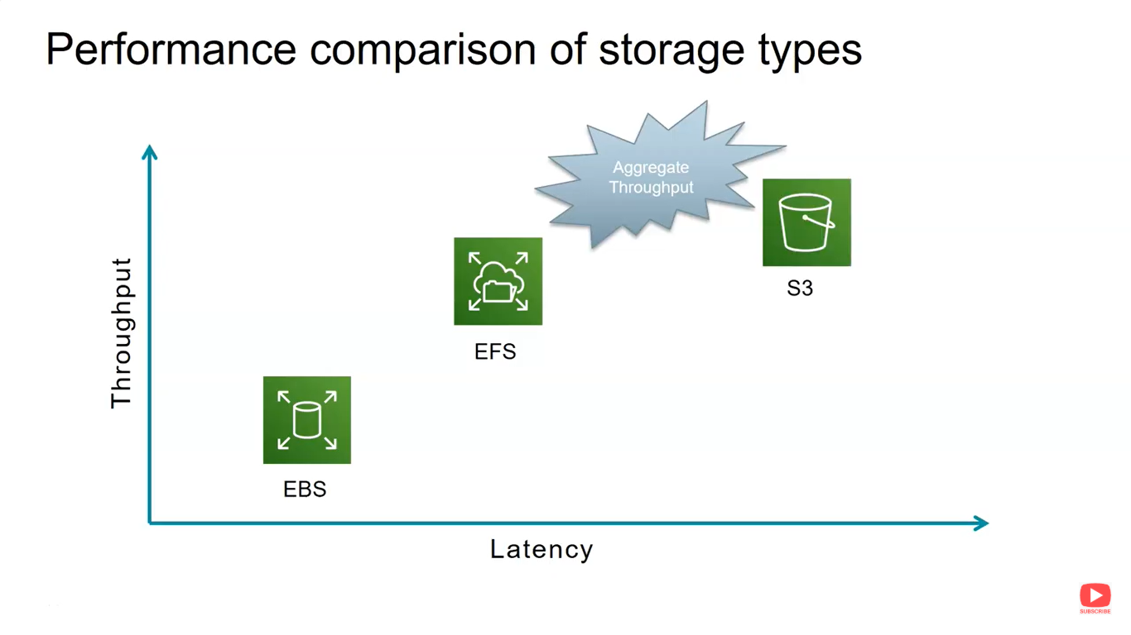
AWS Storage Services

Slide 74
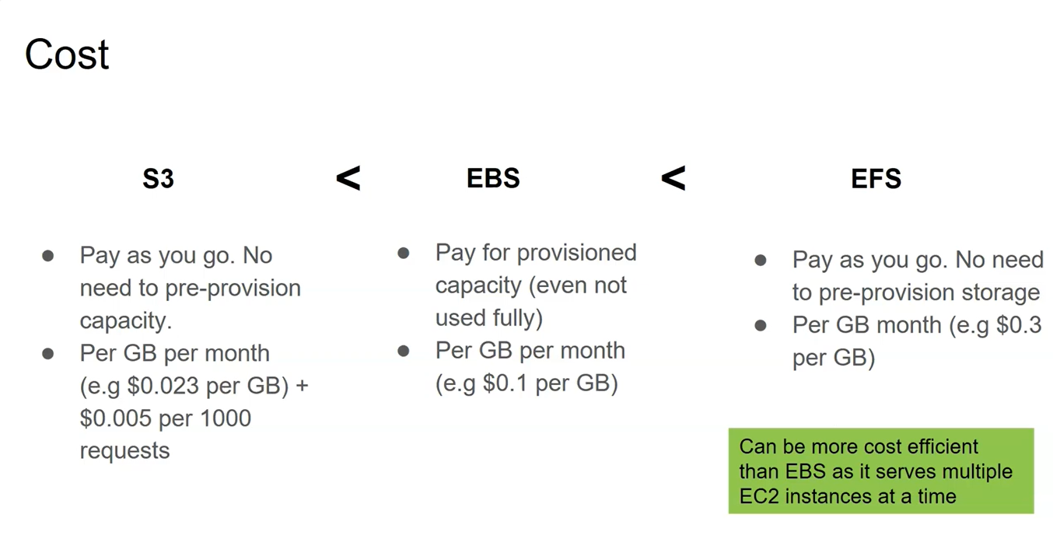
AWS Storage Services

Slide 75
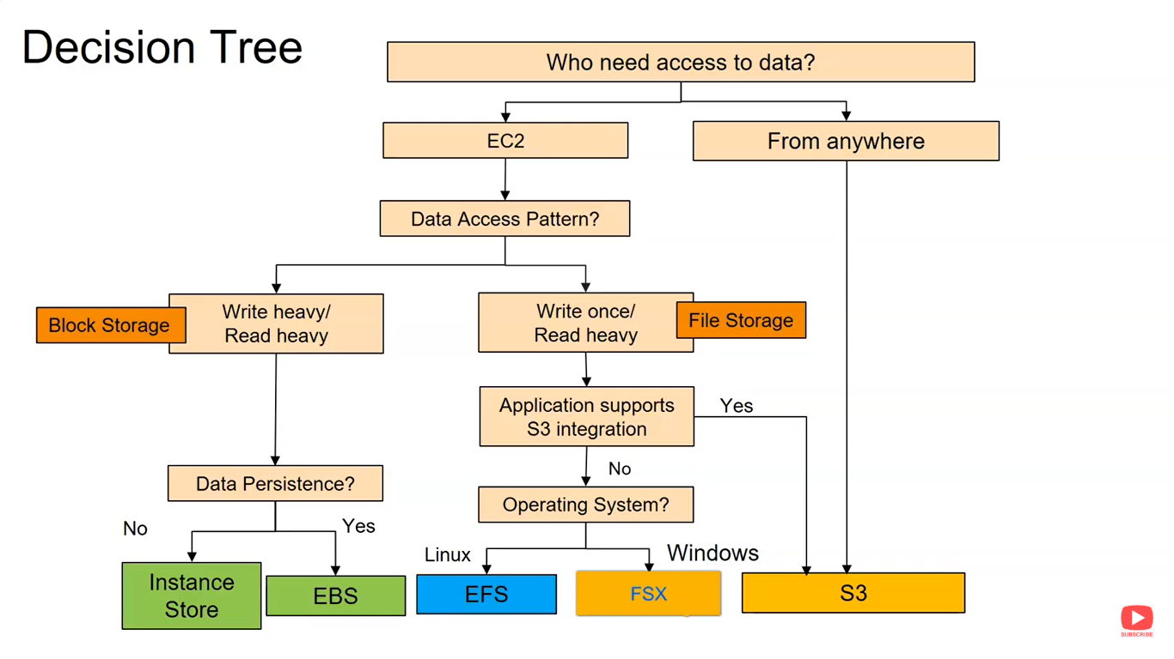
AWS Storage Services

Slide 76
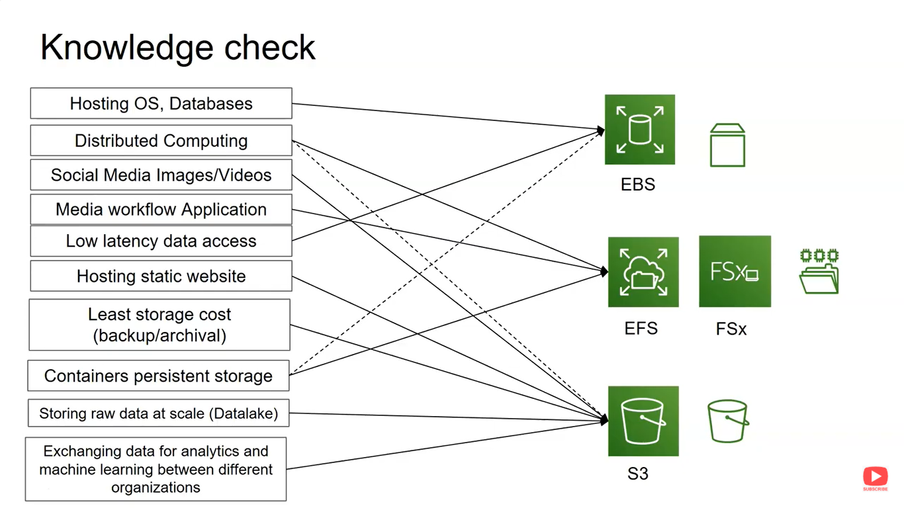
AWS Storage Services

Slide 77
AWS Simple Storage Services
Amazon S3 is a Simple Storage Service in AWS that stores files of different types like Photos, Audio, and Videos as Objects providing more scalability and security to. It is considered as an IaaS (Infrastructure as a Service).
It allows the users to store and retrieve any amount of data at any point in time from anywhere on the web.
It facilitates features such as extremely high availability, security, and simple connection to other AWS Services.
Amazon S3 is used for various purposes in the Cloud because of its robust features with scaling and Securing of data.

Slide 78
What is Amazon S3 Used for?
The following are a few Wide Usage of Amazon S3 service.
Data Storage: Amazon s3 acts as the best option for scaling both small and large storage applications. It helps in storing and retrieving the data-intensitive applications as per needs in ideal time.
Backup and Recovery: Many Organizations are using Amazon S3 to backup their critical data and maintain the data durability and availability for recovery needs.
Hosting Static Websites: Amazon S3 facilitates in storing HTML, CSS and other web content from Users/developers allowing them for hosting Static Websites benefiting with low-latency access and cost-effectiveness. To know more detailing refer this Article – How to host static websites using Amazon S3
Data Archiving: Amazon S3 Glacier service integration helps as a cost-effective solution for long-term data storing which are less frequently accessed applications.

Slide 79
Amazon S3 Storage Classes
This storage maintains the originality of data by inspecting it. Types of storage classes are as follows:
Amazon S3 Standard
Amazon S3 Standard-Infrequent Access
Amazon S3 One Zone-Infrequent Access
Amazon S3 Intelligent-Tiering
Amazon S3 Express One Zone
Amazon S3 Glacier Instant Retrieval
Amazon S3 Glacier Flexible Retrieval
Amazon S3 Glacier Deep Archive
Amazon S3 storage classes for AWS Dedicated Local Zones
Amazon S3 on Outposts

Slide 80
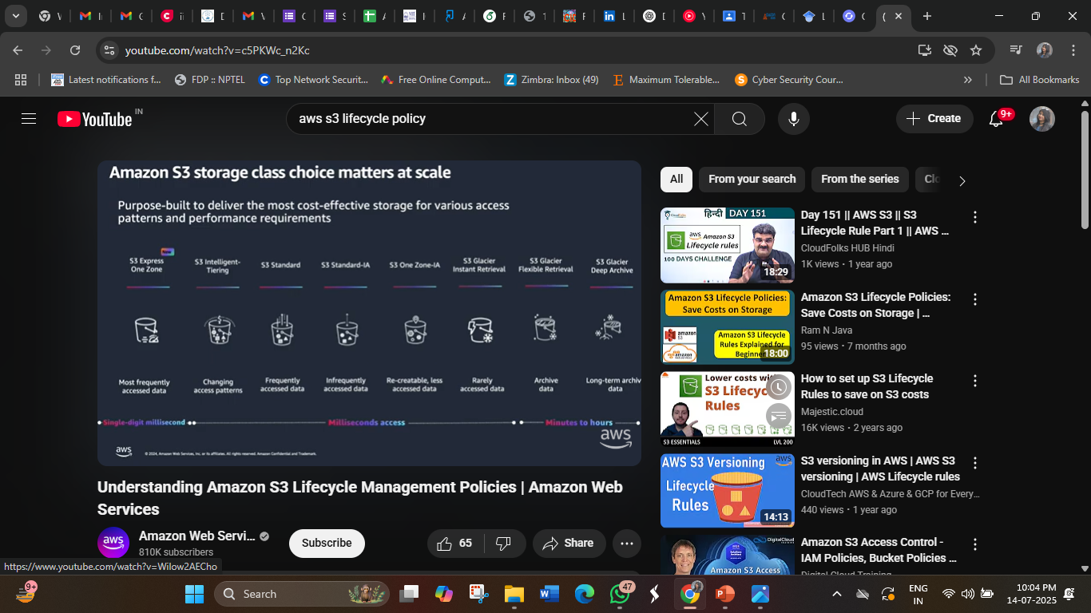
Amazon S3 Storage Classes

Slide 81
Amazon S3 Storage Classes
1. S3 Standard: The Go-to for Frequently Accessed Data
S3 Standard offers high durability, availability, and performance object storage for frequently accessed data. Because it delivers low latency and high throughput, S3 Standard is appropriate for a wide variety of use cases, including cloud applications, dynamic websites, content distribution, mobile and gaming applications, and big data analytics.
Characteristics of S3 Standard:
Availability criteria are quite good like 99.9%.
General purpose storage for frequently accessed data
Low latency and high throughput performance
Improves the recovery of an object file.
Durability of S3 standard is 99.999999999%.

Slide 82
Amazon S3 Storage Classes
2. S3 Intelligent-Tiering: Automated Cost Optimization for Data with Unknown Access Patterns:
The first cloud storage automatically decreases the user’s storage cost. It provides very cost-effective access based on frequency, without affecting other performances.
It is the only cloud storage class that delivers automatic storage cost savings when data access patterns change, without performance impact or operational overhead. The Amazon S3 Intelligent-Tiering storage class is designed to optimize storage costs by automatically moving data to the most cost-effective access tier when access patterns change.
S3 Intelligent-Tiering is the ideal storage class for data with unknown, changing, or unpredictable access patterns, independent of object size or retention period. You can use S3 Intelligent-Tiering as the default storage class for virtually any workload, especially data lakes, data analytics, new applications, and user-generated content. There are no retrieval charges in S3 Intelligent-Tiering.
Characteristics of S3 Intelligent-Tiering:
Required less monitoring and automatically tier charge.
Small monthly monitoring and automation charge.
No operational overhead, no lifecycle charges, no retrieval charges, and no minimum storage duration.
Automatic cost savings for data with unknown or changing access patterns

Slide 83
Amazon S3 Storage Classes
3. Amazon S3 Express One Zone:
Different from other S3 Storage Classes which store data in a minimum of three Availability Zones, S3 One Zone-IA stores data in a single Availability Zone.
S3 Express One Zone can improve data access speeds by 10x and reduce request costs by 50% compared to S3 Standard.
While you have always been able to choose a specific AWS Region to store your S3 data, with S3 Express One Zone you can select a specific AWS Availability Zone within an AWS Region to store your data.
It’s a very good choice for storing secondary backup copies of on-premises data or easily re-creatable data. S3 One Zone-IA provides you the same high durability, high throughput, and low latency as in S3 Standard.
Characteristics :
Availability Zone destruction can damage the data.
Availability is 99.5% in S3 one Zone- Infrequent Access.
Durability is of 99.999999999%.
High performance storage for your most frequently accessed data
Optimized for large datasets with many small objects
Scale to handle millions of requests per minute

Slide 84
Amazon S3 Storage Classes
4. S3 Standard-Infrequent Access: Cost-Effective Storage for Less Frequently Used Data
To access the less frequently used data, users use S3 Standard-IA. It requires rapid access when needed. We can achieve high strength, high output, and low bandwidth by using S3 Standard-IA. It is best in storing the backup, and recovery of data for a long time. It act as a data store for disaster recovery files.
Standard-IA is for data that is accessed less frequently, but requires rapid access when needed. S3 Standard-IA offers the high durability, high throughput, and low latency
Characteristics of S3 Standard-Infrequent Access
High performance and same action rate.
Infrequently accessed data that needs millisecond access
Same low latency and high throughput performance of S3 Standard
Very Durable in all AZs.
Availability is 99.9% in S3 Standard-IA.
Durability is of 99.999999999%

Slide 85
Amazon S3 Storage Classes
5. Amazon S3 One Zone-Infrequent Access: Cost-Effective Storage for Less Frequently Used Data
S3 One Zone-IA is for data that is accessed less frequently, but requires rapid access when needed. Unlike other S3 Storage Classes which store data in a minimum of three Availability Zones (AZs), S3 One Zone-IA stores data in a single AZ and costs 20% less than S3 Standard-IA.
It’s a good choice for storing secondary backup copies of on-premises data or easily re-creatable data.
S3 One Zone-IA is ideal for customers who want a lower-cost option for infrequently accessed data
Characteristics:
Re-creatable infrequently accessed data
Same low latency and high throughput performance of S3 Standard
Availability is 99.9% in S3 Standard-IA.
Durability is of 99.999999999%

Slide 86
Amazon S3 Storage Classes
6. S3 Glacier Instant Retrieval: High-Performance Archiving with Rapid Retrieval
It is an archive storage class that delivers the lowest-cost storage for data archiving and is organized to provide you with the highest performance and with more flexibility. S3 Glacier Instant Retrieval delivers the fastest access to archive storage. Same as in S3 standard, Data retrieval in milliseconds .
Characteristics of S3 Glacier Instant Retrieval
It just takes milliseconds to recover the data.
The minimum object size should be 128KB.
Availability is 99.9% in S3 glacier Instant Retrieval.
Durability is of 99.999999999%
Long-lived data that is accessed a few times per year with instant retrievals

Slide 87
Amazon S3 Storage Classes
7.S3 Glacier Flexible Retrieval: Balancing Cost and Retrieval Flexibility for Archiving
S3 Glacier Flexible Retrieval delivers low-cost storage, up to 10% lower cost (than S3 Glacier Instant Retrieval), for archive data that is accessed 1—2 times per year and is retrieved asynchronously.
For archive data that does not require immediate access but needs the flexibility to retrieve large sets of data at no cost, such as backup or disaster recovery use cases, S3 Glacier Flexible Retrieval (formerly S3 Glacier) is the ideal storage class.
It provides low-cost storage compared to S3 Glacier Instant Retrieval. It is a suitable solution for backing up the data so that it can be recovered easily a few times in a year. It just takes minutes to access the data.
Characteristics :
Free recoveries in high quantity.
Backup and archive data that is rarely accessed and low cost
Supports SSL for data in transit and encryption of data at rest
When you have to retrieve large data sets , then S3 glacier flexible retrieval is best for backup and disaster recovery use cases.
Availability is 99.99% in S3 glacier flexible retrieval.
Durability is of 99.999999999%.

Slide 88
Amazon S3 Storage Classes
8. Amazon S3 Glacier Deep Archive
The Glacier Deep Archive storage class is designed to provide long-lasting and secure long-term storage for large amounts of data at a price that is competitive with off-premises tape archival services that is very cheap.
It is designed for customers—particularly those in highly-regulated industries, such as financial services, healthcare, and public sectors—that retain data sets for 7—10 years or longer to meet regulatory compliance requirements.
You no longer need to deal with expensive services. Accessibility is very much efficient, that it can restore data within 12 hours.
This storage class is designed in such a way that users can easily get long-lasting and more secured storage for a huge amount of data at very less cost. Efficient accessibility and can restore data within very less time, therefore its time complexity is also efficient. S3 Glacier Deep Archive also have the feature of objects replication.
Characteristics of S3 Glacier Deep Archive
More secured storage.
Archive data that is very rarely accessed and very low cost
Retrieval time within 12 hours
Availability is 99.99% in S3 glacier deep archive.
Durability is of 99.999999999%.

Slide 89
Amazon S3 Storage Classes
9. Amazon S3 storage classes for AWS Dedicated Local Zones
In AWS Dedicated Local Zones, the S3 Express One Zone and S3 One Zone-Infrequent access storage classes are purpose-built to store data in a specific data perimeter to support your data isolation and data residency use cases.
Dedicated Local Zones are a type of AWS infrastructure that is fully managed by AWS, built for exclusive use by you or your community, and placed in a location or data center specified by you to help you comply with regulatory requirements. Both storage classes store data in a single Dedicated Local Zone and are supported in directory buckets.
Characteristics:
Store S3 objects in a specific data perimeter
Designed to durably and redundantly store data in a single Dedicated Local Zone

Slide 90
Amazon S3 Storage Classes
10. Amazon S3 on Outposts
Amazon S3 on Outposts delivers object storage to your on-premises AWS Outposts environment. Using the S3 APIs and features available in AWS Regions today, S3 on Outposts makes it easy to store and retrieve data on your Outpost, as well as secure the data, control access, tag, and report on it.
An Outpost is a pool of AWS compute and storage capacity deployed at a customer site. AWS Outposts is a fully managed service that extends AWS infrastructure, services, APIs, and tools to customer premises. By providing local access to AWS managed infrastructure, AWS Outposts enables customers to build and run applications on premises using the same programming interfaces as in AWS Regions, while using local compute and storage resources for lower latency and local data processing needs.
The S3 Outposts storage class is ideal for workloads with local data residency requirements, and to satisfy demanding performance needs by keeping data close to on-premises applications(On-premises in AWS refers to physical devices).
Characteristics:
Store S3 objects in your on-premises AWS Outposts environment
Designed to durably and redundantly store data on your AWS Outposts rack
Authentication and authorization using IAM and S3 Access Points

Slide 91
S3 Lifecycle Policy
An S3 lifecycle policy is a set of rules that define actions to be taken on objects in an S3 bucket over time.
These policies allow you to automate the transition of objects between different storage classes (such as moving data from standard storage to infrequent access storage) or even delete objects after a specified retention period.
Lifecycle policies are highly customizable, allowing businesses to tailor their data management strategies to specific needs.
Lifecycle policies work based on predefined rules set by the user.
These rules specify the conditions that an object must meet to trigger a particular action.
For instance, you can create a rule to transition objects older than 30 days to a cheaper storage class like Glacier, which is suitable for archival purposes. Similarly, you can create rules to permanently delete objects that are no longer needed after a specific timeframe.

Slide 92
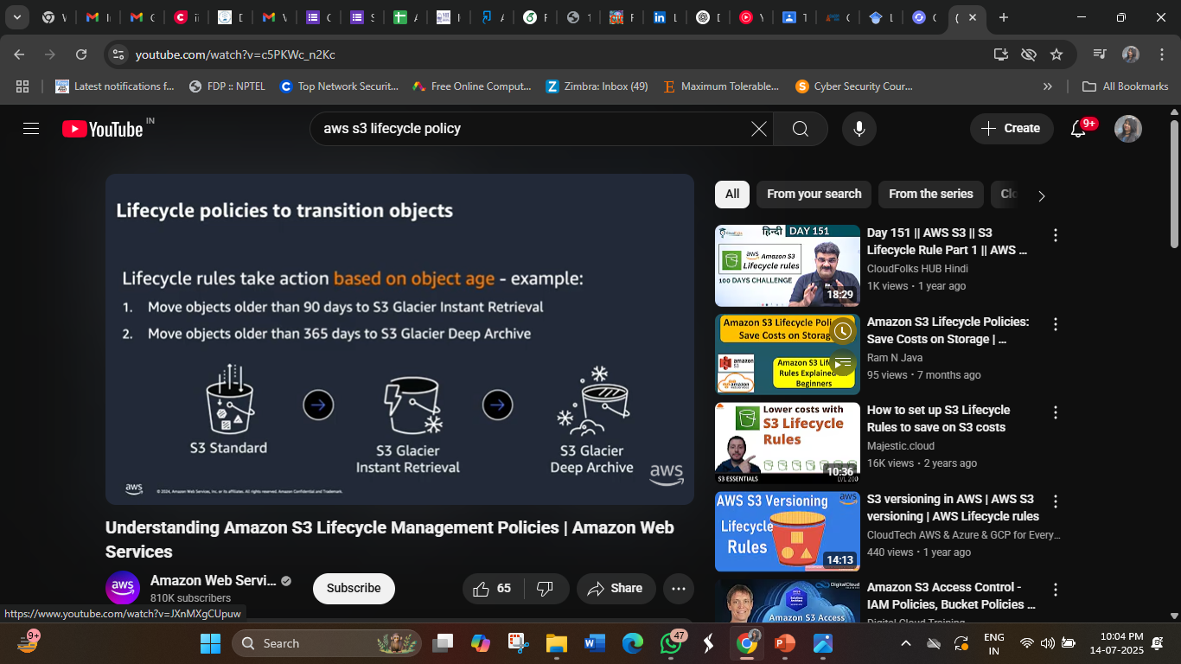
S3 Lifecycle Policy
.

Slide 93
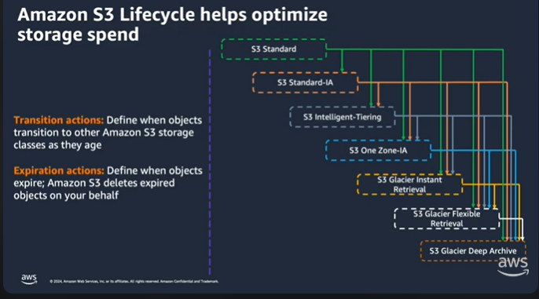
S3 Lifecycle Policy
.

Slide 94
Benefits of Implementing Lifecycle Policies
Implementing S3 lifecycle policies offers several benefits to businesses:
Cost optimization: By automatically moving less frequently accessed data to lower-cost storage classes, businesses can significantly reduce their storage costs without manual intervention.
Efficient data management: Lifecycle policies streamline data management by automating the process of transitioning objects between storage classes or deleting them, saving time and effort for IT teams.
Compliance and security: Lifecycle policies can help enforce data retention policies, ensuring compliance with regulatory requirements. They also enhance security by automating the deletion of sensitive data after its required retention period, reducing the risk of data breaches.
Improved performance: By keeping the storage optimized and clutter-free, lifecycle policies contribute to improved system performance, enabling faster data access and retrieval times.

Slide 95
S3 Lifecycle Policy Examples
Here are some common S3 lifecycle policy examples:
Deleting Objects
One common use of S3 lifecycle policies is to automatically delete objects after a specified period. For instance, businesses can set up a policy to delete temporary files or logs older than 90 days, ensuring that unnecessary data does not clutter their storage space indefinitely.
Moving Objects
Lifecycle policies can also be configured to move objects between different storage classes. For example, you can transition frequently accessed data to the S3 Standard storage class for optimal performance and move less frequently accessed data to the S3 Intelligent-Tiering class to save costs without sacrificing availability and latency.

Slide 96
Amazon EBS (Elastic Block Store)
EC2 is a virtual server in a cloud while EBS is a virtual disk in a cloud.
Amazon EBS allows you to create storage volumes and attach them to the EC2 instances.
Once the storage volume is created, you can create a file system on the top of these volumes, and then you can run a database, store the files, applications or you can even use them as a block device in some other way.
Amazon EBS volumes are placed in a specific availability zone, and they are automatically replicated to protect you from the failure of a single component.
EBS volume does not exist on one disk, it spreads across the Availability Zone. EBS volume is a disk which is attached to an EC2 instance.
EBS volume attached to the EC2 instance where windows or Linux is installed known as Root device of volume.

Slide 97
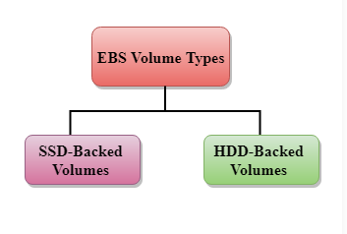
EBS Volume Types
Amazon EBS provides two types of volume that differ in performance characteristics and price. EBS Volume types fall into two parts:
1. SSD-backed volumes
2. HDD-backed volumes
1. SSD
SSD stands for solid-state Drives.
In June 2014, SSD storage was introduced.
It is a general-purpose storage.
It supports up to 4000 IOPS which is quite very high.
SSD storage is very high performing, but it is quite expensive as compared to HDD (Hard Disk Drive) storage.

Slide 98
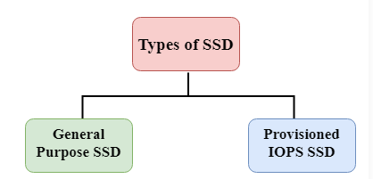
EBS Volume Types
SSD is further classified into two parts:
General Purpose SSD
Provisioned IOPS SSD
General Purpose SSD
General Purpose SSD is also sometimes referred to as a GP2.
It is a General-purpose SSD volume that balances both price and performance.
Provisioned IOPS SSD
It is also referred to as IO1.
It is mainly used for high-performance applications such as intense applications, relational databases.
It is designed for I/O intensive applications such as large relational or NOSQL databases.
It is used when you require more than 10,000 IOPS
General Purpose SSD (gp2) volumes are cost-effective and balance performance and price, while Provisioned IOPS SSD (io1) volumes offer the highest IOPS performance and are best for demanding applications

Slide 99
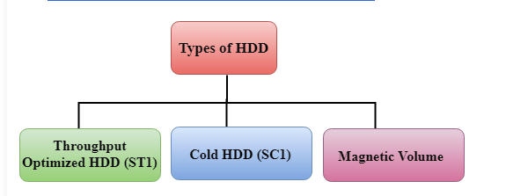
EBS Volume Types
2. HDD
It stands for Hard Disk Drive.
HDD based storage was introduced in 2008.
The size of the HDD based storage could be between 1 GB to 1TB.
It can support up to 100 IOPS which is very low

Slide 100
EBS Volume Types
Throughput Optimized HDD (st1)
It is also referred to as ST1.
Throughput Optimized HDD is a low-cost HDD designed for those applications that require higher throughput up to 500 MB/s.
It is useful for those applications that require the data to be frequently accessed.
It is used for Big data, Data warehouses, Log processing, etc.
It cannot be a boot volume, so it contains some additional volume. For example, if we have Windows server installed in a C: drive, then C drive cannot be a Throughput Optimized Hard disk, D: drive or some other drive could be a Throughput Optimized Hard disk.( A boot volume is the primary disk that contains the operating system (OS) and is required for the system to start (boot). AWS does not allow st1 volumes to be used as boot volumes because these disks are optimized for large sequential data transfers, not for fast random access, which is needed for OS operations. Instead, the boot volume must be a General Purpose SSD (gp2/gp3) or Provisioned IOPS SSD (io1/io2).)
Ex: When launching an EC2 instance, you cannot choose an st1 volume for the root/boot drive. Instead, you use an SSD (gp3 or io2) for booting and add st1 for extra storage.
The size of the Throughput Hard disk can be 500 GiB to 16 TiB.
It supports up to 500 IOPS.

Slide 101
EBS Volume Types
Cold HDD (sc1)
It is also known as SC1.
It is the lowest cost storage designed for the applications where the workloads are infrequently accessed.
It is useful when data is rarely accessed.
It is mainly used for a File server.
It cannot be a boot volume.
The size of the Cold Hard disk can be 500 GiB to 16 TiB.
It supports up to 250 IOPS.
Cold HDD (sc1) is a type of Amazon Elastic Block Store (EBS) volume that provides low-cost, high-throughput storage for workloads that access data infrequently. It is the cheapest EBS storage option and is best suited for cold data storage needs.

Slide 102
EBS Volume Types
Magnetic Volume
It is the lowest cost storage per gigabyte of all EBS volume types.
It is ideal for the applications where the data is accessed infrequently
It is useful for applications where the lowest storage cost is important.
Magnetic volume is the only hard disk which is bootable. Therefore, we can say that it can be used as a boot volume.
Magnetic Volume was one of the earlier Amazon Elastic Block Store (EBS) volume types, providing low-cost storage for applications that require infrequent access to data. Unlike Cold HDD (sc1) or Throughput Optimized HDD (st1), Magnetic volumes were bootable, making them unique among AWS’s HDD-based storage options.

Slide 103
Amazon Glacier
Amazon Glacier, also known as Amazon Simple Storage Service (S3) Glacier, is a low-cost cloud storage service for data with longer retrieval times offered by Amazon Web Services (AWS).
Amazon Glacier provides storage for data archiving and backup of cold data. Cold data refers to files that are infrequently accessed but are kept in case they are needed at a later date.
A developer will use a cold data service such as Amazon Glacier to move data that is not needed often to archival storage to save money on storage costs.
Amazon advertises Amazon Glacier as an extremely low-cost storage service. To keep costs low, the service is optimized for infrequently accessed data -- where data retrieval times can reach from three to five hours.
Amazon S3 Glacier is a low-cost cloud storage service provided by AWS for data archiving and backup of cold data.
Cold data refers to infrequently accessed files that must be retained for long periods (e.g., backups, logs, compliance records).
Amazon Glacier reduces storage costs by optimizing for longer data retrieval times.
Data retrieval can take several hours (3 to 5 hours) instead of being instantaneous like S3 Standard.

Slide 104
Amazon Glacier
When an organization wants to retrieve data, it has three options:
Bulk retrievals, which recover large amounts of data in a five- to 12-hour window; this is the lowest cost option.
Standard retrievals, which take about three to five hours to recover stored data.
Expedited retrievals, which can return data within five minutes. This option, which is the most costly, is designed for organizations that may need their stored data at any time.
Additionally, Amazon considers Amazon Glacier an official part of Amazon Simple Storage Service, which is why it is also called S3 Glacier.

Slide 105
What are the benefits of Amazon Glacier?
Amazon Glacier offers the following benefits:
Lower cost. Glacier is designed as Amazon's lowest-cost storage class. This enables an organization to store large amounts of data at a reduced cost compared to other Amazon storage services.
Maintains archival database. An organization does not have to maintain its own archival database. AWS handles administrative tasks such as capacity planning and hardware
Durability. Glacier is distributed across at least three physical AWS Availability Zones at a time, increasing the ability to restore data if it is lost in one zone.
Scalability. Organizations can scale the stored data up or down as needed.
Multiple data retrieval options. Organizations can choose from expedited, standard and bulk retrievals.
Security. S3 Glacier supports security and compliance standards such as General Data Protection Regulation, Payment Card Industry Data Security Standard, Health Insurance Portability and Accountability Act and Federal Information Security Management Act. It also supports encryption and monitors storage application programming interface call activities.
Integration. Glacier integrates with other AWS offerings such as AWS Snowball and AWS Direct Connect.

Slide 106
Glacier vs. Amazon S3
Although Amazon considers Glacier an official part of S3, they are still two separate storage options with two different use cases.
The biggest difference between the two Amazon storage services is that S3 is designed for data that needs to be retrieved in real time, while Amazon Glacier is used for archival.
Use of S3 Glacier is reserved for low storage cost use cases where data will not be needed at a moment's notice. S3, however, is suggested for when an organization needs frequent and fast access to its data.
While S3 Glacier uses archives and vaults to store data, S3 uses storage buckets.

Slide 107
Glacier vs. Amazon S3
Amazon S3 is a durable, secure, simple, and fast storage service, while Amazon S3 Glacier is used for archiving solutions.
Use S3 if you need low latency or frequent access to your data. Use S3 Glacier for low storage cost, and you do not require millisecond access to your data.
You have three retrieval options when it comes to Glacier, each varying in the cost and speed it retrieves an object for you. You retrieve data in milliseconds from S3.
Both S3 and Glacier are designed for durability of 99.999999999% of objects across multiple Availability Zones.
S3 and Glacier are designed for availability of 99.99%.
S3 can be used to host static web content, while Glacier cannot.

Slide 108
Amazon Elastic File System(EFS)
EFS is a file-level, fully managed, storage provided by AWS (Amazon Web Services) that can be accessed by multiple EC2 instances concurrently.
Just like the AWS EBS, EFS is specially designed for high throughput and low latency applications.
An EFS can be attached to multiple Amazon Web Services (AWS) compute instances and on-premises servers, providing a common resource for applications and data storage in many different environments.
Amazon states that a single EFS can be simultaneously connected to thousands of Elastic Compute Cloud (EC2) instances or on-premise resources, allowing you to share EFS data with as many resources as needed.
Access to shared EFS folders and data is provided through native operating system interfaces.

Slide 109
Amazon Elastic File System(EFS)
Advantages:
An Amazon EFS is elastic. That means its storage capacity can be automatically scaled up (add more storage) or scaled down (shrink storage capacity) as folders and files are added to or removed from the system. This is a major advantage over traditional storage solutions—you can add or remove capacity without disrupting users or applications.
Importantly, EFS storage is permanent. When attached to an AWS compute instance, data will not disappear when that instance is relaunched.

Slide 110
Amazon Elastic File System(EFS)
Disadvantages:
Amazon EFSs do have a couple limitations:
No Windows instances. Amazon EFSs are not supported on AWS Windows EC2 instances. EFS volumes can only be used with non-Windows instances, such as Linux, that support NFS(Network File System) volumes.
No system boot volumes. Amazon EFS volumes also cannot be used for system boot volumes. AWS EC2 instances must use Elastic Block Store (EBS) volumes for booting their systems. EBS volumes are like EFS volumes with one exception. An EBS volume can only be connected to one EC2 instance or server, while EFS volumes can be connected to several EC2 instances and on-premises resources.

Slide 111
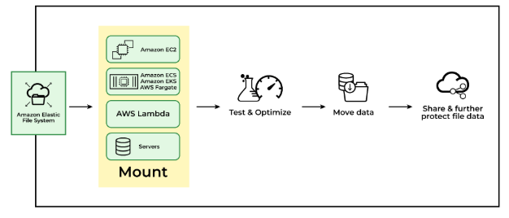
How Does EFS Work?
EFS can be created using the EC2-Instance where it will be created in a specific region and distributed across multiple availability zones for the purpose of high availability and durability. You can choose the EFS based on the I/Ops you are going to perform.
Once the EFS is created you need to set up mount targets which will provide the connectivity to your EFS file system. An EFS (Elastic File System) Mount Target is a network endpoint that enables an EC2 instance to communicate with an EFS file system within a Virtual Private Cloud (VPC). Following are some of the resources which you can mount on EFS.
Amazon EC2.
Amazon ECS.
Amazon EKS.
AWS Fargate.
AWS lambda and some other servers.

Slide 112
Different Storage Classes in AWS EFS
Standard storage class
This is the default storage class for EFS.
The user is only charged for the amount of storage used.
This is recommended for storing frequently accessed files.
Infrequently Accessed storage class(One Zone)
Cheaper storage space.
Recommended for rarely accessed files.
Increased latency when reading or writing files.
The user is charged not only for the storage of files but also charged for read and write operations.

Slide 113
Use Cases Of EFS
Secured file sharing: You can share your files in every secured manner and in a faster and easier way and also ensures consistency across the system.
Web Hosting: Well suited for web servers where multiple web servers can access the file system and can store the data EFS also scales whenever the data incoming is increased.
Modernize application development: You can share the data from the AWS resources like ECS, EKS, and any serverless web applications in an efficient manner and without more management required.
Machine Learning and AI Workloads: EFS is well suited for large data AI applications where multiple instances and containers will access the same data improving collaboration and reducing data duplication

Slide 114
When To Choose Amazon EFS?
Amazon EFS is suitable for the following scenarios:
Shared File Storage: If the multiple EC2-Instances have to access the same data. EFS management of shared data and ensures consistency across instances.
Scalability: EFS can increase and decrease its storage capacity depending on the incoming data. If you don’t have an idea how much data is going to come to the store then you can use the Amazon EFS.
Simplified Data Sharing: If different applications want the same data to use in a collaborative manner then you can choose the Amazon EFS. EFS can share large datasets across a group of instances.
Use with Serverless Applications: Amazon EFS is well suited for the service like serverless computing services like some of the examples AWS lambda, EFS, and so on.
Pay-as-You-go-Model: If your application is having unpredictable storage growth then there is no need of paying upfront or no need of any prior commitments. You pay only for the storage that you are going to use.

